Slide 1

Land
Jeshua 1:1-9

Slide 2
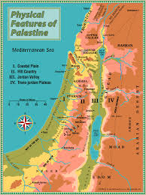
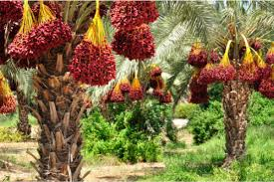
Questions
Why did God give the land of Canaan to the people of Israel?
How did the people of Israel obtain the land?
Joshua
1:2, I have already given the children of Israel (acquiring the land)
1:2, But only the place where my feet tread is my land (possessing the land)
1:7-8, We must act according to the word to protect the land. (Protecting the land)

Slide 3
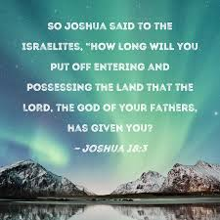
1. The land has already been given.
The land is not something that you acquire by fighting for it, but it has already been given.
1:3, ‘I will give you every place’
1:6, ‘I will give this people the land that I swore to their fathers that I would give them’.
This land was already promised by God long ago.
Gen 13:14, ‘Lift up your eyes from where you are and look northward and southward and eastward and westward. I will give it to you and your descendants forever.’ Gen 15:13-14, ‘Your descendants will be strangers in a land that is not theirs and will serve them, and they will afflict them four hundred years... After that, they will come out with great wealth.’
Ex 3:8, ‘So I have come down to rescue them from the hand of the Egyptians and to bring them up oft of that land into a good and spacious land, a land flowing milk and honey...’.

Slide 4

Walter Bruggemann, ‘The Land’
1. Gift
2. Temptation
3. Task
4. Promise

Slide 5
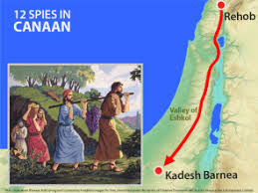
12 Spies in Numbers 13-14
Numbers 13:26, ‘At the end of the 3rd day they returned from exploring the land’. However, Joshua and Caleb, among the 12 spies, had different thoughts.
Numbers 13:30, ‘We should go up and take possession of the land’.

Slide 6
Exploring or Conquering?
Deuteronomy 1:8, 1:21, 1:39, 2:24,
‘Go in and take possession of the land’.
What is the land to you? Your future, your business, your gift, your mission, your family, your life, your job, your destiny, your mission....
Lev 25:23, ‘The land must not be sold permanently, because the land is mine and you reside in my land as foreigners and strangers’

Slide 7
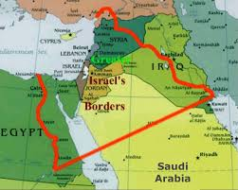
2. But it will be mine only if I step on it with my foot.
The Wilderness where Israelites walked
Joshua 1:4, "From the wilderness and this Lebanon to the great river, the River Euphrates, all the land of the Hittites, and to the Great Sea toward the going down of the sun, shall be your territory."

Slide 8
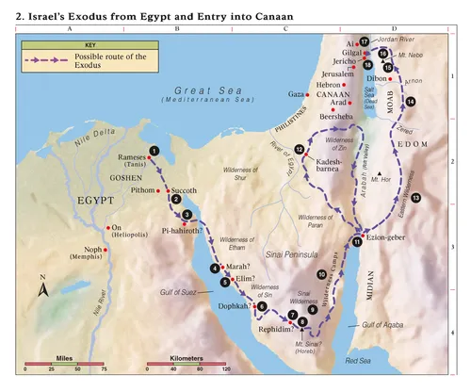
Numbers
Num 1-10 (Preparation to start) | Num 11-20 (Wandering) | Num 21-36 (Preparation to enter)
Mount Sinai | Wilderness | Trans Jordan
Origanization of the people | From Kadesh to Plains of Moab | Reotoranization

Slide 9
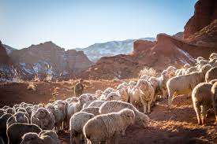
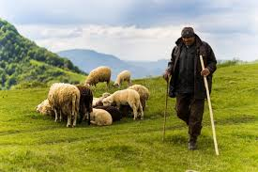
4 Human Problems
Food | Water | Roads | Conflict
Fear | emotional
Conflict | relational
Insect | spiritual
Hunger | existential
5 Ministries of the Shepherd based on Psalm 23
Provider | Leader | Protector | Nurturer | Dweller

Slide 10
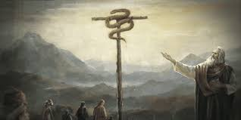
Bronze Serpent (Num 21)
Numbers 21:8, ‘The Lord said to Moses, ’Make a snake and put it up on a hole: anyone who is bitten can look at it and live’.
John 3:15. ‘That everyone who believes may have eternal life in him’.

Slide 11
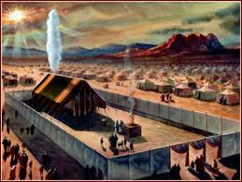
Moving Tabernacle in the Wilderness
Numbers 9:18, ‘At the Lord’s command the Israelites set out , and at his command they encamped. As long as the cloud stay over the tabernacle, they remained in camp’
Numbers 10:14, ‘The division of the camp of Judah went first’
Numbers 9:17, ‘Whenever the cloud lifted from above the tent, the Israelites set out’

Slide 12
3. We must act according to the word in order to live on the earth
Joshua 1:7-8, ‘Be strong and very courageous. Be careful to obey all the law my servant Moses gave you; do not turn from it to the right or to the left, that you may be successful wherever you go, Keep the Book of the Law always on your lips, meditate on it day and night, so that you may be careful to do everything written it. Then you will be prosperous and successful.’

Slide 13
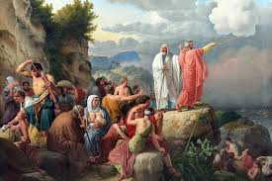
DEUTERONOMY
Focus | 1st Sermon | 2nd Sermon | 3rd Sermon
Bible | 1:1-4:43 | 4:44-26:19 | 27:1-34:12
Topic | What God has done? | What God expected of Israel? | What God will do?
 | Remember Grace (Past) Keep the Word (Present) |  | Commit you rself (Future)

Slide 14
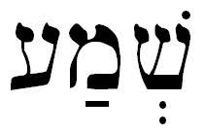
1) Remember (Deuteronomy 6)
Deuteronomy 15:15, ‘Remember that you were slaves in Egypt and the Lord you God redeemed you. That is why I give you this command today’. Remember and Keep appear here.
Shema (6:4-9), ‘Hear, O Israel: The Lord out God, the Lord is one (4). Love the Lord your God with all your heart and with all your soul and with all your strength (5). …Impress them on your children (7)’

Slide 15
2) Keep (Deuteronomy 12)
Contents | Bible | Signficance
Preparation | Deut 12:3, ‘Break down their altars, smash their sacred stones’
Place | Deut 12:5, ‘Seek the place the Lord your God will choose’
Participants | Deut 12:18, ‘You, your sons and daughters, your male and female servants, and the Levites from your town’
Offerings | Deut 12:6, ‘Bring your burnt offerings and sacrifices, your tithes and special gifts, what you vowed to give and your freewill offering and the firstborn of your herds and flocks’
Attitude | Deut 12:12, ‘There rejoice before the Lord your God’
Results | Deut 12:28, ‘Be careful to obey all these regulations I am giving you, so that it may always go well with you and your children’

Slide 16
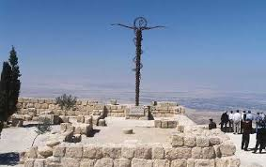
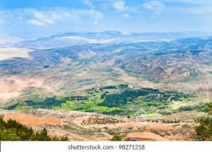
3) Commit (Deuteronomy 34)
Deuteronomy 34:7 ‘Moses was a hundred twenty years old when he died, yet his eyes his were not weak nor his strength his gone’.
Hebrew 3:5, ‘Moses was faithful as a servant in all God’s house, bearing witness to what would be spoken by God in the future’

Slide 17
Summary and Reflection
Summary | Land was given not by exploring but by possessing | Walking through the wilderness to the Land | Living in the Land by remembering, keeping the Word
 | Joshua | Numbers | Deuteronomy
Application

