Slide 1

Ruth
Ruth 4:13-22

Slide 2
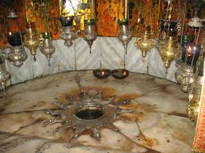
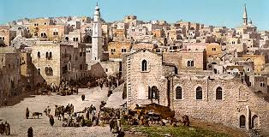
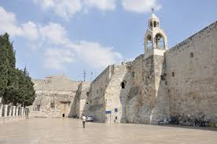
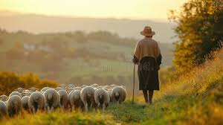
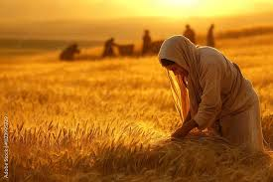
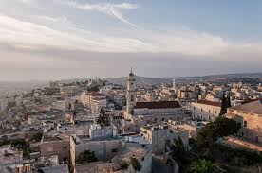
Bethlehem

Slide 3
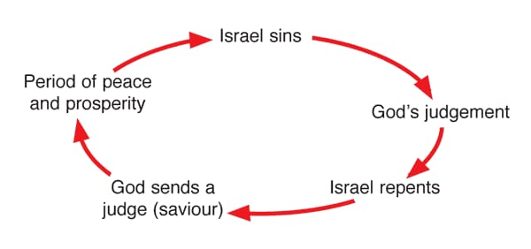
Background of Judges
Ruth1:1,itissaidtobe‘during the time when the judges ruled’,
Judges21:25describesthistimeas“there was no king, and men did what was good in their eyes.”
 | Othniel | Ehud | Deborah | Gideon | Jephthah | Samson
Apostacy (Sin) | 2:11-13 | 3:7 | 3:12 | 4:1 | 6:1 | 13:1
Servitude (Punishment) | 2:14-15 | 3:8 | 3:12-14 | 4:2 | 6:1-6 | 13:1
Supplication (Cry) and Salvation (Deliverance) | 2:16-18 | 3:9-11 | 3:15-31 | 4:3-24 | 6:6-8:28 | 13:24

Slide 4
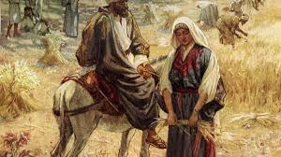
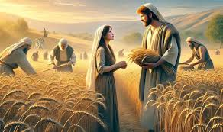
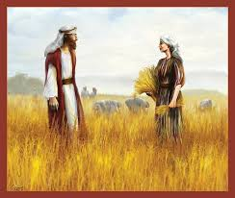
1. Love Story
Chapter | 1 | 2 | 3 | 4
Literary form | Beginning | Development | Climax | Ending
Contents | Suffering(famine, death, moving) :Human condition of suffering | Boaz and Ruth: God’s plan for salvation | Love of Boaz and Ruth: Christ Redemption | David and Jesus: Completion of salvation and New Creation

Slide 5
Matthew 1:5, Salmon the father of Boaz, whose mother was Rahab, Boaz the father of Obed , whose mother was Ruth, Obed the father of Jesse’.
Ruth 4:21-22, “Boaz fathered Obed, Obed fathered Jesse, and Jesse fathered David.”
Rahab | Salmon
Ruth | Boas

Slide 6
2. Christ’s Genealogy
4 Periods of History of Israel
. Abraham-David(14)
. David-Babylonia(14)
. Babylonia-Jesus (14)
4 women in genealogy
. Tamar
. Boaz
. Ruth
. Bathsheba
Genealogy of Christ(Matthew 1:1-17)
Abraham--->Rahab and Salmon--->Boaz and Ruth-->Obed-->Jesse-->David (14 generations)-----------Babylonia (14 generations)------------------>Jesus Christ(14 generations)

Slide 7
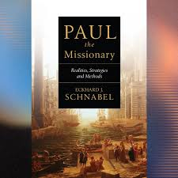
3. Missional Message
Eckhard J.Schnabel, Paul the Missionary
Intentional Geographic Moving | Personal Conversion | Faith Community(Church) | Discipleship and Sending for Reproduction

Slide 8
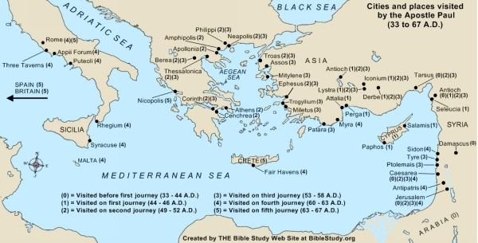
1) Intentional Moving
. Bethlehem-Moab
. Moab-Bethlehem
Region | City | Acts | Event
Syria | Antioch | 13:1-14:28
Galatia | Picidian Antioch | 13:14-52
 | Lystra, Iconion | 14:1-20
 | Derbe | 14:1-28
Macedonia | Phillipi | 16:11-40
 | Thessalonica | 17:1-9
 | Berea | 17:10-15
Achaea | Athens | 17:16-34
 | Corinth | 18:1-17
Asia | Ephesus | 19:1-20:1
Rome |  | 28:30-31

Slide 9
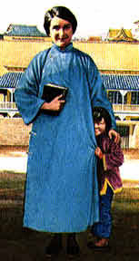

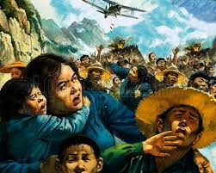
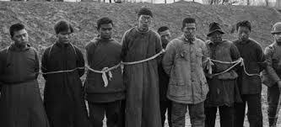
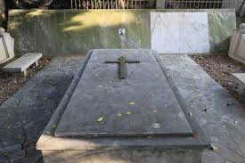
Gladys Aylward (1902-1970)
‘Therefore, go…’(Mat28:19)

Slide 10
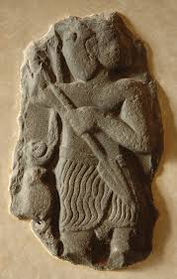
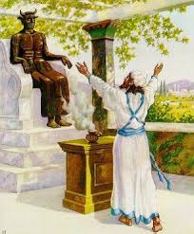
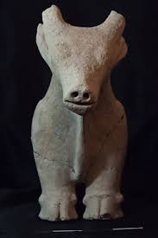
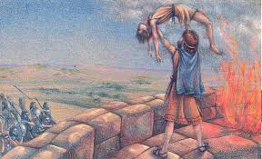
2) Personal Conversion
Ruth1:16, ‘But Ruth replied, ‘‘Don’t urge me to leave you or to turn back from you. Where you go I will go, and where you stay I will stay. Your people will be my people and your God is my God’.

Slide 11
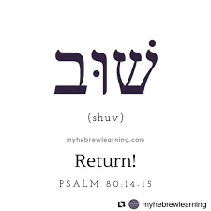
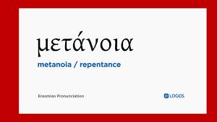
Isaiah 44:22, “You come back to me. For I have redeemed you”
Malachi 3:7, “Return therefore to me. Then I too will return to you”(Malachi 3:7).
Isiah 55:7, “Let the unjust man abandon his thoughts and return to the Lord. Then he will have mercy on you”
1 Thess 1:9, ‘They tell how you turned to God from idols to serve the living and true God’
Matt 3:2, ‘Repent, for the Kingdom of Heaven has come near“
Luke 3:3,8, ‘He went into all the country around the Jordan, preaching a baptism of repentance for the forgiveness of sins’ ‘Produce in fruit in keeping with repentance’.
Luke 15:21, ‘The son said to him, ’Father, I have sinned against heaven and against you’
A theologian said: “If you open your heart to the eye of a needle towards God, God is always ready to come down to you in a golden chariot.”

Slide 12
3) Faith Community (Church)
* Christology determines missiology and missiology determine eccelesiology
Symbols of Salvation
Ruth | Boaz | Naomi | Ruth and Boaz
Moabite Eph 2:3(by nature deserving of wrath) Sinner | Redeemer (Goel) Lev 25:23-25 (redeem) Christ | Mediator Ruth 3:1 (rest) Church | Children Mat 28:19 (make disciples) Mission
Christology determines missiology, and missiology determines ecclesiology

Slide 13
What is salvation?
Salvation in the Book of Ruth
Justification | Redemption | Adoption | Reconciliation | Atonement
Romans 3:24 (Court) | 1 Corinthians 6:19-20 (Slave Market) | Galatians 4:5-7 (Family) | Ephesians 2:13-14 (Family union) | Hebrew 9:12 (Temple)
Ruth belonged to holy people | Boas bought Ruth’s inheritance again | Boas adopted Ruth as his wife | Jew and Moabite became family | Boas sacrificed himself for Ruth

Slide 14
Salvation of Jews and Gentiles (Romans 9-11)
(1) Don’t consider yourself superior to Israel
Romans 11:18, ‘Do not consider yourself to be superior to those other branches’.
Romans 11:20, ‘Do not arrogant, but tremble’
(2) Root and Branches
Romans 11:17-18, ‘If some of the branches have been broken off, and you, though a wild olive shoot, have been grafted in among the others and now in the nourishing sap from the olive root. ... You do not support the root, but the root supports you’. (‘Bastazo’=‘bear, carry, lift up’, ‘support’)
(3) At last all Israel will be saved
Romans 11:25, “I do not want you to be ignorant of this mystery, brothers and sisters, so that you may not be conceited: Israel has experienced a hardening in part until the full number if the Gentiles has come in”
Romans 11:26, ‘and in this way all Israel will be saved’
Romans 11:29, ‘for God’s gifts and his call are irrevocable’
Grafted into Israel
Gentiles | The Jews
Branches | Root
Ephesians 2:11-13, Gentiles by birth, uncircumcised, separated from Christ, excluded from citizenship in Israel without hope and God in the world. | Romans 9:1-6, Theirs is the adoption to sonship, the divine glory, covenants, law, temple worship and promise

Slide 15
4) Discipleship for Reproduction
Ruth 4:21-22, ‘Salom the father of Boaz, Boaz the father of Obed, Obed the father of Jesse, and Jesse the father of David’.
. Discipleship Model in the Book of Ruth
1) Home is the center of discipleship.
Deuteronomy 6:4-9, “Hear, O Israel: The LORD our God is one LORD; you shall love the LORD your God with all your heart and with all your soul and with all your strength. These words, which I am commanding you today, shall be on your heart. You shall teach them diligently to your children’.
(1) Who to teach?
(2) What to teach?
(3) How to teach?
Step | Characteristics
Child | Spiritual Child Needing Forgiveness of Sin (Salvation)
Youth | The Sin-fighting Course of the Spiritual Youth (Sanctification)
Father | The process of spiritual maturity to escape from sin and know about God (Glorification)
(2) It should be step by step
(3) Jesus Christ is the cause, the method and the purpose of Discipleship
John 5:39
(4) We must continue to train and re-product the disciples of Jesus for the establishment of Kingdom of God in the world.

Slide 16
Summary and Application
Schnabel | Intentional Geographical Moving | Personal Conversion | Faith Community (Church) | Discipleship and sending for Reproduction
Ruth
Jesus (Paul)
Your Church, You

