Slide 1

Jeremiah
Jer 31:4, 31, 33, 29:4-7, Lam 3:32

Slide 2
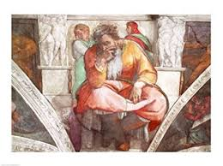
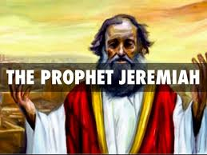
Who is Jeremiah?
_________________________________________________________________________
627 612 605 597 587 582 ?
Calling Fall of Assyria 1st Attack 2nd Attack Fall of Temple Death of Zedekiah Taken to Egypt
King Josiah Weeping prophet Died

Slide 3
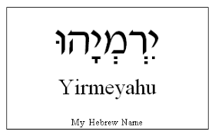
1. Salvation for All Nations
1) I will establish
1:5, ‘Before I formed you in the womb I knew you, before you were born I set you apart; I appointed you as a prophet to the nations’.
1:10, ‘See, today I appoint you over nations and kingdoms to uproot and tear down, to destroy and overthrow, to build and to plant’
31:4, ‘I will build you up again, and you, Virgin Israel, will be rebuilt. Again you will take up your timbrels and go out to dance with the joyful’
45:4, ‘But the Lord has told me to say to you, ’This is what the Lord says, ‘I will overthrow what I have built and uproot what I have planted, throughout the earth’.

Slide 4
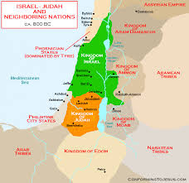
2) All Nations
25:19-26, ‘19 Pharaoh king of Egypt, his attendants, his officials and all his people, 20 and all the foreign people there; all the kings of Uz; all the kings of the Philistines (those of Ashkelon, Gaza, Ekron, and the people left at Ashdod); 21 Edom, Moab and Ammon; 22 all the kings of Tyre and Sidon; the kings of the coastlands across the sea; 23 Dedan, Tema, Buz and all who are in distant places[a]; 24 all the kings of Arabia and all the kings of the foreign people who live in the wilderness; 25 all the kings of Zimri, Elam and Media; 26 and all the kings of the north, near and far, one after the other—all the kingdoms on the face of the earth. And after all of them, the king of Sheshak[b] will drink it too.

Slide 5
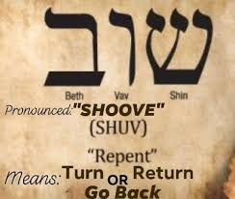
3) Return
4:1, ‘If you, Israel, will return, then return to me’, declares the Lord, ‘If you put your detestable idols out of my sight and no longer go astray’
Lamentation, 5:21, ‘Restore us to yourself, Lord, that we may return; renew our days as of old’

Slide 6
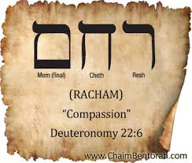
4) Compassion
Lamentations 3:32, “Because of the LORD's great love we are not consumed, for his compassions never fail.”
9:1. “Oh, that my head were a spring of water and my eyes a fountain of tears! I would weep day and night for the slain of my people.”
Lamentations 2:11. “My eyes fail from weeping, I am in torment within, my heart is poured out on the ground”.
Ephesians 2:7. 'in order that in the coming ages he might show the incomparable riches of his grace, expressed in his kindness to us in Christ Jesus.'
Lamentations 3:22, “Because of the LORD's great love we are not consumed, for his compassions never fail.”

Slide 7
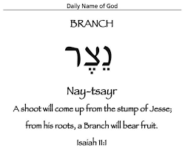
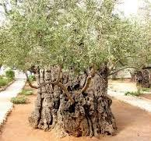
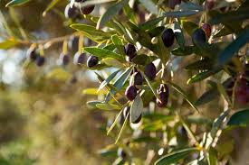
5) Branch
23: 4-6, 4 I will place shepherds over them who will tend them, and they will no longer be afraid or terrified, nor will any be missing,” declares the Lord. 5 The days are coming,” declares the Lord, when I will raise up for David[a] a righteous Branch, a King who will reign wisely and do what is just and right in the land. 6 In his days Judah will be saved and Israel will live in safety. This is the name by which he will be called: The Lord Our Righteous Savior.
33:15, ‘In those days and at that time. I will make a righteous Branch sprout from David’s line; he will do what is just and right in the land’.

Slide 8
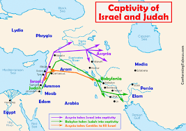
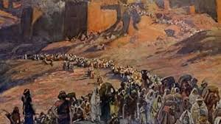
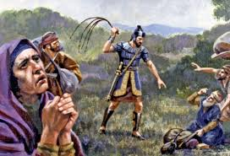
2. Mission in Babylonia
29:4-7, “This is what the LORD Almighty, the God of Israel, says to all those I carried into exile from Jerusalem to Babylon: "Build houses and settle down; plant gardens and eat what they produce. Marry and have sons and daughters; find wives for your sons and give your daughters in marriage, so that they too may have sons and daughters. Increase in number there; do not decrease. Also, seek the peace and prosperity of the city to which I have carried you into exile. Pray to the LORD for it, because if it prospers, you too will prosper."

Slide 9
What kind of world where we were sent?
Will Bruce, ‘Mission is living in enemy country’.
Matthew 10:16, “I am sending you out like sheep among wolves. Therefore be as shrewd as snakes and as innocent as doves.”
We are all spiritual captives living in Babylon. Some are captives of money, some are captives of power, some are captives of sex, and all are captives of sin. But we do not live in that land forever. We will return when the time comes. Captives are not settlers. We live there only until the one who sent us tells us to return. Can’t we live by viewing the land we live in as a mission field, viewing the people we meet as poor captives, and viewing ourselves as sinners who need God’s grace and mercy? We should not leave the place we live, but should stay there and bloom (bloom where planted). The place we live is a holy mission field sent by God. We are heavenly people living in enemy territory.

Slide 10
3. New Covenant
Jeremiah 31:33. '"This is the covenant I will make with the house of Israel after that time," declares the LORD. "I will put my law in their minds and write it on their hearts. I will be their God, and they will be my people’.
William Paul Young, <The shack>, ‘You must believe in two things to overcome life's fears. It is that I am always good and that I always love you.’

Slide 11
What happened in Israel after the Babylonian Captivity for 70 years?
1) The temple and the faith in God were restored.
2) Longing for the Messiah got intensified.
3) The emergence of the synagogue.
4) The transmission and documentation of the Bible.
5) The appearance of the diaspora.

Slide 12
Where is your Babylonia?
1:10, “See, today I appoint you over nations and kingdoms to uproot and tear down, to destroy and overthrow, to build and to plant."
31:4 is the words that shows the characteristics of Jeremiah best. “I will build you up again and you will be rebuilt, O Virgin Israel. Again you will take up your tambourines and go out to dance with the joyful.”

