Slide 1

Zechariah

Slide 2

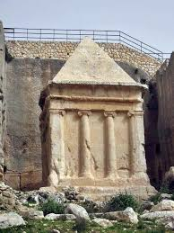
Tomb of Zechariah in Jerusalem

Slide 3
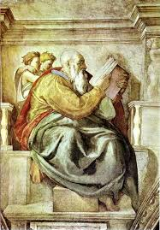
Picture in Vatican

Slide 4
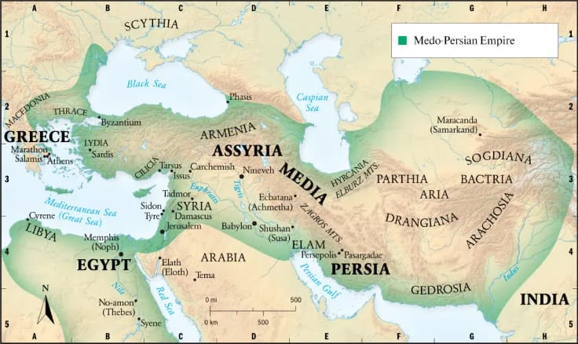
Six Empires and Israel
Has Israel been lived like an isolated island separated from the World History?

Slide 5
Major three group prophets
Kingdom of Judah | Babylonian Empire |  | Persian Empire
King Joshia Zedekiah | Babylonian Attacks 612 605 597 587 | Babylonian Captivity | Cyrus defeated Babylonia
640 B.C 627 B.C |  | 587-515 B.C | 539 B.C
Habakkuk Jeremiah Zephaniah was born | Daniel Ezekiel | Jeremiah, Ezekiel, Daniel | Haggai, Zechariah Esther, Ezra, Nehemiah,

Slide 6
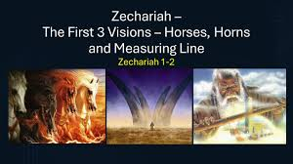
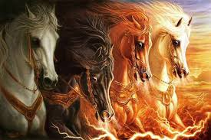
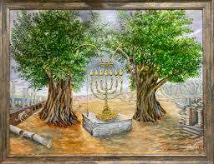
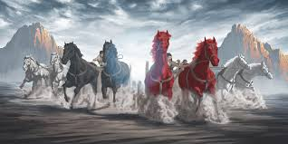
1) Book
Zechariah 1:1
Matthew 23:35
Haggai and Zechariah
2) Structure
(1) 8 illusions
. 1:7-17, four men on horseback . 1:18-21, the four horns and the four blacksmiths . Chapter 2, the measuring line . Chapter 3, Joshua's clothes . Chapter 4 , the lampstand and the olive tree. 5:1-4. Flying scroll . 5:5-11, woman seated on an ephah . 6:1-8, four horses
(2) Four messages: 7:4-7, 8-14, 8:1-17, 8:19-23
(3) Two warnings: Chapters 9-11, 12-14

Slide 7
Joshua’s Clothes | . Zechariah 3: 1-2, “Then he showed me Joshua the high priest standing before the angel of the Lord, and Satan [a] standing at his right side his to accuse him. 2 The Lord said to Satan, “The Lord rebuke you, Satan! The Lord, who has chosen Jerusalem, rebuke you! Is not this man a burning stick snatched from the fire?” . Zechariah 3:4, "The angel said to those who were standing before him,” Take off his filthy clothes. “ Then he said to Joshua, See I have taken away your sin and I will put fine garments on you.”
(Seven Lamps | . Zechariah 4:2, "I see a solid gold lamp stand with a bowl at the top and seven lights on it." It is a vision of seven lights. . 4:3, "there are two trees by it"
Flying Scroll | . Zechariah 5.1-2, "I looked again and there before me was a flying scroll. He asked me, "What do you see?" I answered, "I see a flying scroll, thirty feet long and fifteen feet wide." . Zechariah 5:3-4 “And he said to me, “This is the curse that is going out over the whole land; for according to what it says on one side, every thief will be banished, and according to what it says on the other, everyone who swears falsely will be banished.4 The Lord Almighty declares, 'I will send it out, and it will enter the house of the thief and the house of anyone who swears falsely by my name. It will remain in that house and destroy it completely, both its timbers and its stones.'”
Spring Rain | . Zechariah 10:1. “Ask the Lord for rain in the time of the latter rain. The Lord will make flashing clouds; He will give them showers of rain, Grass in the field for everyone.” . Zechariah 10:1. “Ask the Lord for rain in the springtime; it is the Lord who sends the thunderstorms. He gives showers of rain to all people, and plants of the field to everyone.”

Slide 8
Missional Vision of zechariah
Visions of Zechariah
Joshua’s Clothes | Seven Lamp | Flying Scroll | Spring Rain
Zech 3:1-5 | Zech 4:1-7 | Zech 5:1-4 | Zech 10:1-12
Sin (cleaning) | Spirit (power) | Sending (Mission) | Salvation (restoration)

Slide 9
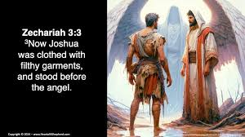
1) Jushua’s clothes
1) Joshua’s Clothes
Zechariah 3: 1-2, “Then he showed me Joshua the high priest standing before the angel of the Lord, and Satan standing at his right side his to accuse him. 2 The Lord said to Satan, “The Lord rebuke you, Satan! The Lord, who has chosen Jerusalem, rebuke you! Is not this man a burning stick snatched from the fire?”
Zechariah 3:4, "The angel said to those who were standing before him,” Take off his filthy clothes. “ Then he said to Joshua, See I have taken away your sin and I will put fine garments on you.”
‘A burning stick snatched from the fire’(2)
‘ Rebuke you, Satan’ (2)
‘Take off his filthy clothes’ (3)
‘Put a clean turban on his head and clothed him’(5)

Slide 10
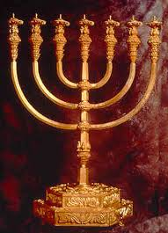
2) Seven Lamps
Zechariah 4:2, "I see a solid gold lamp stand with a bowl at the top and seven lights on it." It is a vision of seven lights.
Zechariah 4:3, "there are two trees by it“
Exodus 27:20, ‘Command the Israelites to bring you clear oil of pressed olives for the light so that the lamps may be kept burning’
Oil (Shemen)-Holy Spirit (Neshama)
E.M.Bounds, ‘All efforts come from man, all power comes from God’

Slide 11
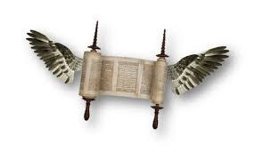
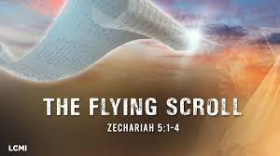
3) Flying Scroll
. Zechariah 5.1-2, "I looked again and there before me was a flying scroll. He asked me, "What do you see?" I answered, "I see a flying scroll, thirty feet long and fifteen feet wide."
. Zechariah 5:3-4 “And he said to me, “This is the curse that is going out over the whole land; for according to what it says on one side, every thief will be banished, and according to what it says on the other, everyone who swears falsely will be banished.4 The Lord Almighty declares, 'I will send it out, and it will enter the house of the thief and the house of anyone who swears falsely by my name. It will remain in that house and destroy it completely, both its timbers and its stones.'”

Slide 12

Papirus

Slide 13
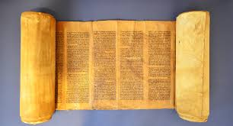
Scroll

Slide 14
Let the Word of God fly to all over the world

Slide 15
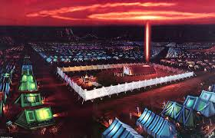
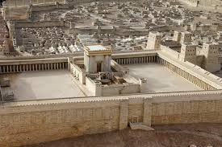
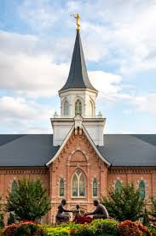
Flying scroll
(1) ‘Flying’=present continuous
(2) Every thief and anyone who swears falsely will be banished(destroyed)
Hebrew 4:12, ‘For the word of God is alive and active, sharper than any double-edged sword’
(3) 20 cubits long and 10 cubits wide=size of the Temple

Slide 16
“The church which ceases to be evangelistic will soon cease to be evangelical.” –Alexander Duff, 1806-1878, India
“If you don’t have a definite call to stay here, you are called to go.”– Keith Green
“If you take missions out of the Bible, you won’t have anything left but the covers.”– Nina Gunter
“Sympathy is no substitute for action.” –David Livingstone, 1813-1873, missionary to Africa
“Christ alone can save the world, but Christ cannot save the world alone.”–David Livingstone, 1813-1873, missionary to Africa
“The mark of a great church is not its seating capacity, but its sending capacity.”– Mike Stachura
“The church that does not evangelize will fossilize.” –Oswald J. Smith
“It’s not that God has a mission for his Church in the world, but that God has a Church for his mission in the world.” – Chris Wright

Slide 17
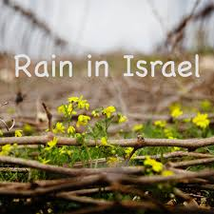
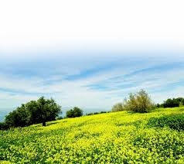
4) Spring Rain
Zechariah 10:1. “Ask the Lord for rain in the springtime; it is the Lord who sends the thunderstorms. He gives showers of rain to all people, and plants of the field to everyone.”
Rain in Israel
October-November | December-February | March-April
Fall Rain (Early Rain) | Winter Rain | Spring Rain (Late Rain)
Sowing | Growing | Reaping

