Slide 1

Mark

Slide 2
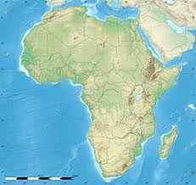
Questions
When did the African church begin?
When did the African receive the gospel?
Is Africa the descendant of Ham?

Slide 3
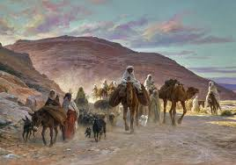
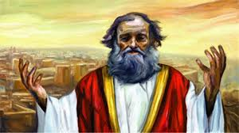
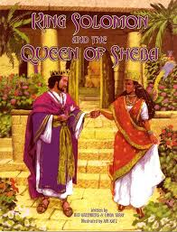
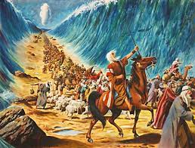
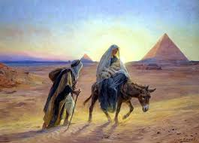
Bible and Africa
The patriarch
Israel’s history
Exodus
Solomon and Sheba
Jeremiah
Jesus
Ethiopian Eunuch

Slide 4
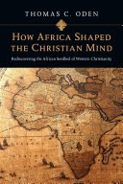
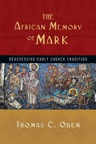
Thomas Oden
(1) How Africa Shaped the Christian
Mind (2009)
(2) The African Memory of Mark (2011)
“ The early church in Africa in 50 to 500 A.D was the seedbed of the faith that formed the world church today”.

Slide 5
Mark in the New Testament
Act 1:13, ‘they went upstairs to the room’ (Mark’s Upper Room)
Mk 14:51-52. ‘Left a linen garment behind’
Act 15:37-38, ‘deserted Paul during the 2nd mission journey’
Col 4:10, ‘Mark, the cousin of Barnabas’
1 Pet 5:13, ‘my son Mark’
2 Tim 4:11, ‘Get Mark and bring him with you, because he is helpful in my ministry’

Slide 6
Mark in the history
Historian Eusebius (300-325 AD, 'They say that this Mark was the first apostle to preach the gospel of Christ in Egypt' (Ecclesiastical History, 2.16.1).
The Coptic Orthodox Church describes the history of Mark as follows, 'The spread of the gospel in Alexandria was so great that wherever Saint Mark went, there were quarrels and disturbances among the Gentiles. As an apostle, Mark appointed a bishop (Anianos), three priests, and seven deacons. When he was away from the church of Alexandria for a while, he met Peter and Paul in Rome and stayed with them until their martyrdom in 64. Returning to Alexandria again in 65, Mark first visited his hometown of Pentapolis, where he preached for two years with many miracles, and finally returned to Alexandria and founded a church near Baucalis (Bucli).' (Coptic Orthodox Church data)

Slide 7
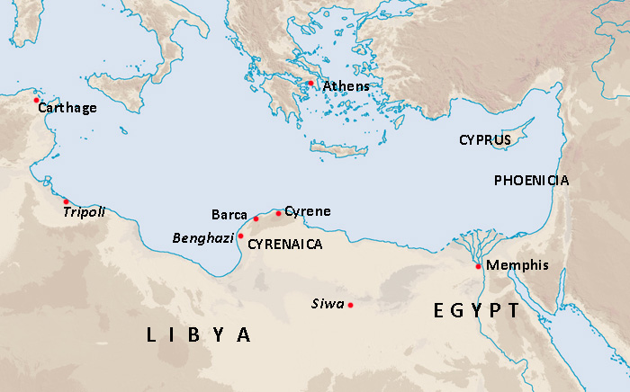
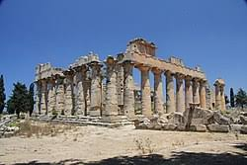
1) Mark in Africa
He was a Diaspora Levitic Jew who was born in Pentapolis (now Lybia)
His name; ‘John’ (Heb. God is kind), ‘Mark’ (Latin. hammer)
His father was Aristoporus, his mother was Maria
As a Jew, he would have studied not only the Bible but also Greek and Latin, which were the languages ​​that young people of that time received. It was part of God’s great providence to write the Book of Mark later.

Slide 8
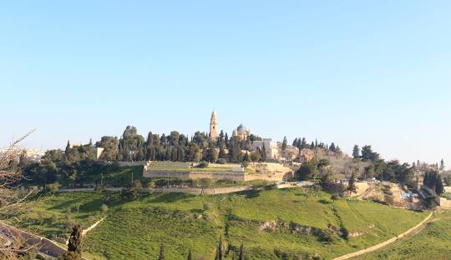
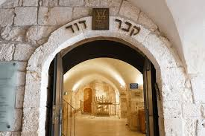
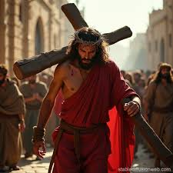
2) Mark in Jerusalem
After father’s death, Mark and his mother returned to Jerusalem and settled in the Mount Zion area
Mark 14:51-52 , A young man, wearing nothing but a linen garment, was following Jesus. When they seized him, ⁵² he fled naked, leaving his garment behind.

Slide 9
3) Peter and Paul
Mark came to know Jesus through Peter
Act 1: 12-14, ’Then the apostles returned to Jerusalem from the hill called the Mount of Olives, a Sabbath day’s walk from the city. When they arrived, they went upstairs to the room where they were staying. Those present were Peter, John, James and Andrew; Philip and Thomas, Bartholomew and Matthew; James son of Alphaeus and Simon the Zealot, and Judas son of James. They all joined together constantly in prayer, along with the women and Mary the mother of Jesus, and with his brothers’.
Mark joined Paul’s mission team, but not successful.
Act 15:36-39 , ‘Some time later Paul said to Barnabas, “Let us go back and visit the believers in all the towns where we preached the word of the Lord and see how they are doing.” Barnabas wanted to take John, also called Mark, with them, but Paul did not think it wise to take him, because he had deserted them in Pamphylia and had not continued with them in the work.. They had such a sharp disagreement that they parted company. Barnabas took Mark and sailed for Cyprus’.

Slide 10
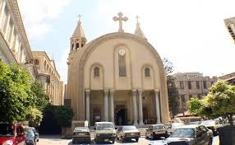
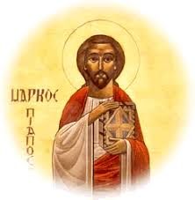
4) To Alexandria again
The first place Mark arrived when he left for Africa was his hometown, Cyrene (present-day Libya).
Act 2:10, Phrygia and Pamphylia, Egypt and the parts of Libya near Cyrene; visitors from
The he moved Alexandria, there he planted the first African Church

Slide 11
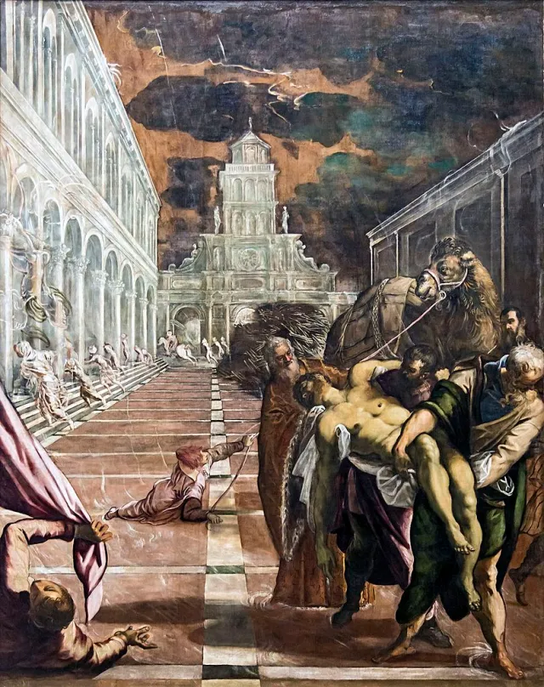
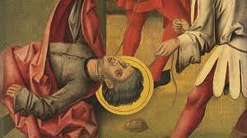
5) Martyrdom
He came to Alexandria in 43 A.D., wrote the Gospel of Mark in 55 A.D. in Rome
He was with Peter and Paul in Rome until their martyrdom.
2 Tim 4:11, ‘Get Mark and bring him with you’ “When you come, bring Mark with you”.
He returned to Alexandria in 65 AD again and was martyred in 68 AD
His last prayer, 'Lord, thank you. I entrust me to your good hands.' When he said this, he fainted, and a sound from heaven was heard. "Blessed Mark, the evangelist and my chosen Mark, be blessed." When he heard this voice, Mark shouted again with all his strength. 'Thank you, my Lord Jesus Christ. Thank you for making me suffer for your name.‘

Slide 12
Reconstruction of the Life of St. Paul and St. Mark
Paul’s Chronology | Year | Bible | Mark’s Chronology | Events
 |  |  | Around 10-20 | Born in Cyrene
 |  |  | Around 20-30 | Moved to Jerusalem
 |  |  | 30 | Left Jesus leaving a linen garment (Mk 14:51-52)
 |  |  | 30-31 | . Pentecost at the Upper Room . Heard the preaching Peter (Act 1-3)
Conversion | 33 |  | (1)
After conversion(Arabia, Damascus) | 33-36 | Gal 1:16-17
1st Visit to Jerusalem | 37 | Gal 1:18
1st Mission Journey | 47-48 | Act 13:1-15:35 |  | Joined Paul’s 1st Mission, but returned to Jerusalem (Act 15:38)
2nd Mission Journey | 49-51 | Act 15:36-18:22 | (2)
3rd Mission Journey | 55-56 | Act 18:23-20:38 | 55 | Wrote the 1st Gospel of Mark in Rome
Arrested and Prisoned in Caesaria (Israel) | 57-58 | Act Chs. 21-26 | (3)
4th Mission Journey | 59-61 | Act Chs.27-28 | 61-64 Back to Alexandria through Cyrene and founded the first church in Africa
Arrested in Rome | 62
Prisoned again | 62-64 | Act 28:30-31 | 64 Visit Rome to comfort Peter and Paul in jail
Martyred | 64
 |  |  | 65 | Returned to Alexandria
 |  |  | 68 | Martyred in Alexandria

Slide 13
African Church after Mark
1) His basic message: Discipleship and Mission
(1) It starts with calling.
(2) The word ‘12 disciples’ is used the most (9 times).
(3) He uses the word ‘crowd’, ‘followers of Jesus’ (the crowd) about 20 times, indicating that disciples are not simply a group of people who follow Jesus.
(4) Jesus teaches his disciples three times about what a disciple is and what they should do before the Passion (8:34-38, 9:33-37, 10:35-45)
(5) The Gospel of Mark records the disciples’ mistakes unusually often.
(6) Mark’s disciples are not only those who learn, but also those who are sent out into the world. ‘Send’ (apostelein = “to send out. 20 times). hypagein = “to go” (15x; esp. 1:44; 2:11; 5:19, 34; 6:38; 7:29; 8:33; 10:21, 52; 11:2; 14:13; 16:7)
Mark was not a disciple who learned directly from Jesus, but he saw Jesus' teachings as a command to deny himself and follow the Lord, and that discipleship is not just about learning, but is a missionary command to be 'sent' and fulfill the Lord's will. He believed as he learned, lived as he believed, and died as he lived.

Slide 14
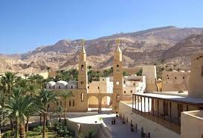
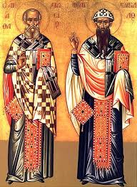
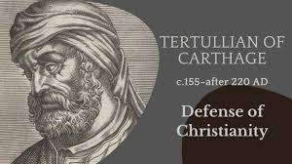
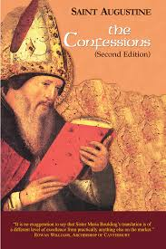
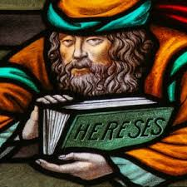
2) Church fathers for 500 years
Clement (150)
Tertullian (160)
Origen (185)
Cyprian (200)
St. Anthony (251)
Athanasius (295)
St. Augustine (354)

Slide 15


7 Major influences of the early African churches on the Christian Church
(1) Emergence of university
(2) Influence of Biblical Interpretation
(3) Establishment of Christian doctrine
(4) Ecumenical movement
(5) Monastic movement
(6) Neo-platonic philosophy
(7) Dialectical skills

Slide 16
Summary and Discussion
What was Africa in the Bible and Christianity, especially early Christianity?
2. Who was St. Mark?
3. What do you learn from St. Mark?
4. How do you apply the lessons from St. Mark to your life and African Mission?

