Slide 1

Luke

Slide 2
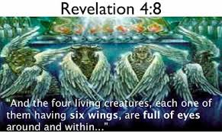
1. Four Gospel
Synoptics Jesus is seen in common from the human side (earth). |  |  | John Seeing Jesus as a Divine Being (Heaven)
Matthew | Mark | Luke | John
Lion (King) | Cow (Servant) | Man (Humanity) | Eagle (God)
Mt 2:2, ‘Where is the one who has been born king of the Jews? | Mk 8:34, ‘Whoever wants to be my disciple must deny themselves and follow me’ | Lk 19:10, ‘For the Son of Man came to seek and to save the lost’ | John 3:15 ‘That everyone who believes may have eternal life in him’

Slide 3
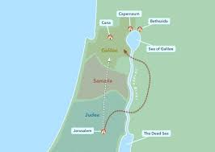
1) Who is Luke?
Col 4:14, ‘Our dear friend Luke, the doctor’
‘We,’ Acts 16:11, 20:6, 21:18, 27:1, 28:16
2) Structure of Luke
Lk 1:1-9:50 | Lk 9:50-18:43 | Lk 19:1- 24:53
Galilee | Samaria | Jerusalem

Slide 4
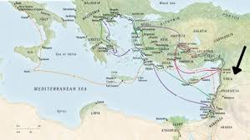
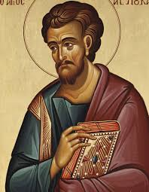
2. Luke, Book of Mission
Luke 1:1-4, ‘1Many have undertaken to draw up an account of the things that have been fulfilled[a] among us, 2 just as they were handed down to us by those who from the first were eyewitnesses and servants of the word. 3 With this in mind, since I myself have carefully investigated everything from the beginning, I too decided to write an orderly account for you, most excellent Theophilus, 4 so that you may know the certainty of the things you have been taught’
* Gospel for Gentiles
10: 1-2, Jesus sent 70 disciples
Not use the word’ Rabbi’, but ‘teacher’ for Jesus
Genealogy of Jesus begins with ‘Adam’ not with ‘Abraham’
Luke 3:38. ‘38 the son of Enosh, the son of Seth, the son of Adam’

Slide 5
Mission in History
Luke 3:1-2,3 In the fifteenth year of the reign of Tiberius Caesar—when Pontius Pilate was governor of Judea, Herod tetrarch of Galilee, his brother Philip tetrarch of Iturea and Traconitis, and Lysanias tetrarch of Abilene— 2 during the high-priesthood of Annas and Caiaphas, the word of God came to John son of Zechariah in the wilderness.
Roman Emperor Tiberius (14-37, A.D)
Pontius Pilate (26-36. A.D)
Herod Antipas (B.C 4-39 A.D)
Annas (18-36 A.D)

Slide 6

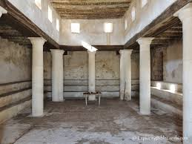
2) Announcement of Mission
Luke 4:18-19, ‘The Spirit of the Lord is on me, because he has anointed me to proclaim good news to the poor. He has sent me to proclaim freedom for the prisoners and recovery of sight for the blind, to set the oppressed free, 19 to proclaim the year of the Lord’s favor. 20 Then he rolled up the scroll, gave it back to the attendant and sat down. The eyes of everyone in the synagogue were fastened on him. 21 He began by saying to them, “Today this scripture is fulfilled in your hearing‘.
Bring good news to the poor
Proclaim release to the captives
Proclaim recovery of sight to the blind
Let the oppressed go free
Proclaim the year of Jubilee

Slide 7
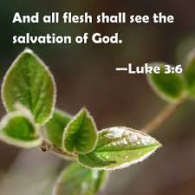
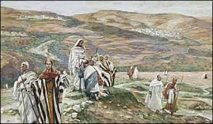
3) Object of Mission
Luke 2:32, ‘(Jesus) a light for revelation to the Gentiles and glory to your people Israel’.
Luke 3:6, ‘And all flesh shall see the salvation of God’
Luke 19:10, ‘For the Son of Man has come to seek and to save the lost’.
(1) Gentiles
7:1-16, Healing the centurion’s servant.
17:11, Healing of the ten Samaritan lepers
10:1-23, Preached in the cities of Tyre and Sidon

Slide 8
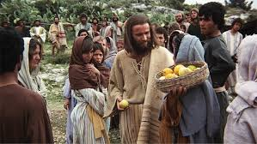
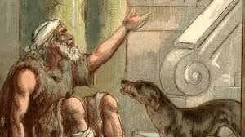
(2) The Poor
. Stories of the poor in Luke: 6:20, 24; 12:16-21; 16:19-31; 19:1-10).
. Luke 6:20, ‘Blessed are the poor’ (Matthew 5:3, ‘blessed are the poor in spirit)
. Interest in the poor: parables of the rich fool (Luke 12:13-21), Lazarus and the rich man (Luke 16:19-31)

Slide 9
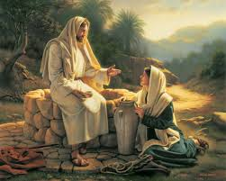
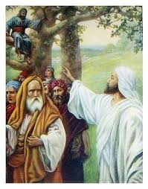
(3) The Marginalized(
Luke 5:31, ‘Those who are well have no need of a physician, but those who are sick. I have come to call not the righteous but sinners to repentance’.
Samaritan mission: 9:51f; 10:25ff; 17:19
Luke 19:1-9, story of Zacchaeus

Slide 10
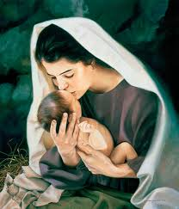
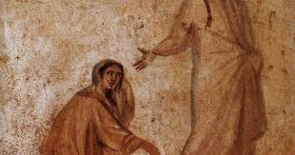
(4) Women
Woman | Luke | Contents
Elizabeth | 1:24-25,41-45
Mary | 12:48.52
Peter’s mother i Law | 4:38-39
Anna | 2:38
Widow of Nain | 7:10-17
Woman who anointed Jesus feet | 7:36-50
Three women who supported Jesus | 8:13
Joanna | 24:10
A poor widow | 21:1-4
Bleeding woman | 8:42-48
Mary and Martha | 10:38-42
Woman who was healed | 13:10-17
Persistent widow of prayer | 18:1-8
Women who witnessed the risen Christ | 24:1-10

Slide 11
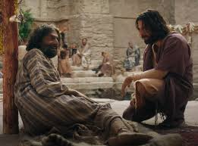
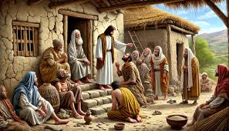
(5) Gospel for the lost
. Women’s gospel: Mary, Elizabeth, Anna, The leprous widow, the woman anointed, Mary and Martha, Mary Magdalene
. Poor people: 2:24 (Gifts from the poor), 7:22 (Gospel to the poor),
. Lost people: 15 (Parable of the lost son), 17(Lepers), 18(Pharisees and tax collectors), 19(Zacchaeus the tax collector), 23 (repentant criminal)
. Oppressed people: 10:25-37 (Parable of the Samaritans), 17:11-19(Gratitude among the lepers), 4:25-27 (Story of the widow od Zarephath and Naaman), 7:2-10(Faith of the centurion)

Slide 12
4. Ways of Mission
Luke 24:46-49, ‘46 He told them, “This is what is written: The Messiah will suffer and rise from the dead on the third day, 47 and repentance for the forgiveness of sins will be preached in his name to all nations, beginning at Jerusalem. 48 You are witnesses of these things. 49 I am going to send you what my Father has promised; but stay in the city until you have been clothed with power from on high’.
Death and Resurrection of Christ
Repentance and Forgiveness
(3) Witness
. Proclamation
. Persuasion
. Presence
+
. Power

Slide 13
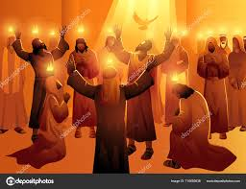
5) Power of Mission
Luke 1:15, ‘John was filled with Holy Spirit even from birth”
Luke 3:16, ‘Jesus is the one who will baptize with the Holy Spirit’
The Holy Spirit is involved time and again in the birth narratives. John is said to be “filled with Holy Spirit even from birth” (1:15). The Spirit is the agent of the incarnation (1:35);Elizabeth, (1:41) Zechariah (1:67) and Simeon (2:25-27) are moved, filled or revealed to, by the Holy Spirit. In Jesus’ ministry the influence of the Spirit continues: Jesus is the one who will baptize with the Holy Spirit (3:16) and is filled with the Spirit at his baptism (3:22). He returns from the Jordan full of the Spirit, is led immediately into the desert by the Spirit (4:1) and returns triumphant to Galilee in the power of the Spirit (4:14).
The Spirit is the Spirit of mission. Jesus’ mission is inaugurated because the Spirit is upon him (4:18) and the disciples are filled with the Holy Spirit to empower them for their mission (Acts 2:17-21).
He gives tongues to the apostles (Acts 2). Stephen is full of the Spirit in his work (6:3) and when he is preaching (6:10). The Spirit directs Philip in his conversation with the eunuch (8:8-29) and then transports him elsewhere (8:39). The Spirit makes the preparations and directs the special event in which Cornelius receives the gospel. In another key moment in Acts, the council of Jerusalem, the Gentiles are recognized to be Christians because they have received the same Spirit as the Jewish Christians. Finally, the Spirit directs Paul and his companions (13:2, 4; 16:6).

Slide 14
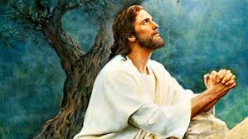
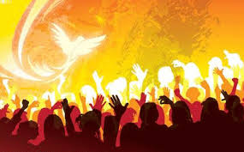
Prayer
3:21,22, When he was baptized, the heaven opened
5:15-16, The busier, the more he prayed
6:12-13, He prayed all night before making an important decision
9:18-27, When he was praying, he told first about his death and resurrection
9:28-36, He prayer on the mountain with three disciples
11:1-4, He taught the prayer through prayer
22:44, He prayer in the garden of Gethemane
22:31, He promised to pray for Peter who betrayed him
5:15-16, describes the life of prayer of Jesus in detail
. Teachings on prayer: 11(parable of the friend) , 18(the parable of the unjust judge), 22:46 (Pray not to fall into temptation), 11:13 (The Holy Spirit will be given when praying)

Slide 15
Mission in Luke and Acts
Mission in Luke and Acts
Fulfillment | Holy Spirit | Suffering | All Nations
Luke 1:1 Mission is the fulfillment of God's promise. | Mission is the initiative action of the Holy Spirit. | Acts 14:22 The gospel, which began with the suffering of the cross, is spread through our suffering. | Acts 1:8 Mission continues until the ends of the earth are reached and all nations are saved.

Slide 16
6. Parables in Luke
Prayer | Parable of Widow (Lk 18:1-8) | Parable of the widow ancient societies were agricultural societies. Therefore, the widow without her husband had no choice but to live in poverty because of the difficulties in farming. The parable of the widow teaches the necessity of earnest prayer, crying out day and night.
 | Parable of Tax-collector (Lk 18:9-14) | The Pharisee prays loudly and reveals himself. The publican, on the other hand, does not lift his face and prays while beating his chest. This parable teaches the sincerity of prayer, the importance of prayer from the heart.
The Lost | Lost Sheep (Lk 15:3-7) | In Luke 15, Jesus told his parables with the theme of three lost things. Lost sheep, lost money, lost son.
 | Lost Coin (Lk 15:8-10)
 | Lost Son (Lk 11:32)
Material | Parable of the debtor (Lk 7:36-50) | This parable teaches that if I want forgiveness, I must forgive others.
 | Parable of the Unjust Manage (Lk 16:1-9) | Do not aim for money, make God your only purpose, and give money to people if you can.
loving the week | Parable of the Good Samaritan (Lk 10:25-37) | The parable of the Samaritan is a parable of love for one's suffering neighbor.

Slide 17
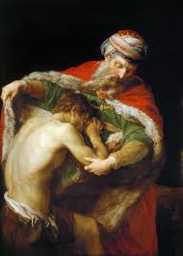
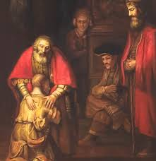
Parable of Lost Son (15:11-32)
. Sharing inheritance
. Pigs and carob
. I have sinned against heaven and against you
. His father saw and ran to his son
. Bring the robe
. Bring the fattened calf
. His father pleaded with him
. He was lost and is found

Slide 18
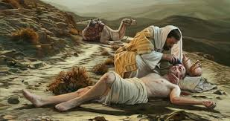
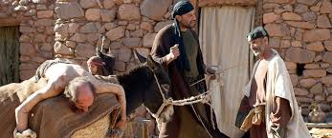
Parable of good Samaritan (10:25-37)
. Going down from Jerusalem to Jericho
. Robbers
. A priest and a Levite
. Oil and wine
. He took pity on him
. He brought him to an inn
. Two denarii
. When I return

