Slide 1

Acts

Slide 2
Acts
1. Author
“
2. Structure
Acts 1:8, ‘But you will receive power when the Holy Spirit comes on you; and you will my witnesses in Jerusalem,
and in all Judea and Samaria, and to the ends of the earth
Focus | Jerusalem (1:1-8:4) | Judea and Samaria (8:5-12:25) | End of the Earth (13:1-28:31)
Targets | Jews | Samaritans | Gentiles
Main figures | Peter (Power of the Church) | Philip (Progress of the Church) | Paul (Expansion of the Church)
Time | 2 years (33-35.A.D) | 13 years (35-48 A.D) | 16 years (48-64 A.D)

Slide 3
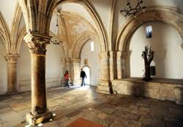
1. Jerusalem Church
Jerusalem Church | Acts 1:12-14, 2:1-13, 4:42-47 | . The Jerusalem church is the mother of all churches and the starting point of all missions. 1) Prayer, the beginning of missions . Acts 1:13-14, “Peter, John, James, Andrew and Philip, Thomas and Bartholomew, Matthew, and James the son of Alphaeus, Simon the Zealot, and Judas the son of James were all there. They devoted themselves to prayer, together with the women and the mother of Jesus and the brothers of Jesus.” 2) The Holy Spirit, the source of mission . Acts 2:1. “When the day of Pentecost had come, they were all gathered together in one place.” . 3P, 4W, 4G . Holy Spirit is 3P (person, power, presence) and 4 W worship, word, and work, witness and 4G (Grace, Group, Gift, Growth).

Slide 4
Pentecost
2:1, ‘When the day of Pentecost came, they were all together in one place.’
Exodus 19:16, ‘On the morning of the third day there was thunder and lightning, with a thick cloud over the mountain, and a very loud trumpet blast. Everyone in the camp trembled.’
Growth and Change
Growth | 2:47 (Number of believers increased day by day), (3,000), 4:4 (5,000), 5:14 (More than ever believers were added to the Lord), 6:7 (Number of the disciples multiplied greatly), 9:31 (Church throughout all Judea and Galilee and Samaria was being built up, 16:5 (They increased in numbers daily)
Change | 2(The Holy Spirit descended, Jerusalem was bewildered), 17 (Thessalonica was disturbed after the Gospel was preached), 19(Ephesus), 25(Jerusalem), 17:6(These men who have turned the world upside down have come here), 24:5(This man a plague, one who stirs up riots among all the Jews throughout the world)

Slide 5
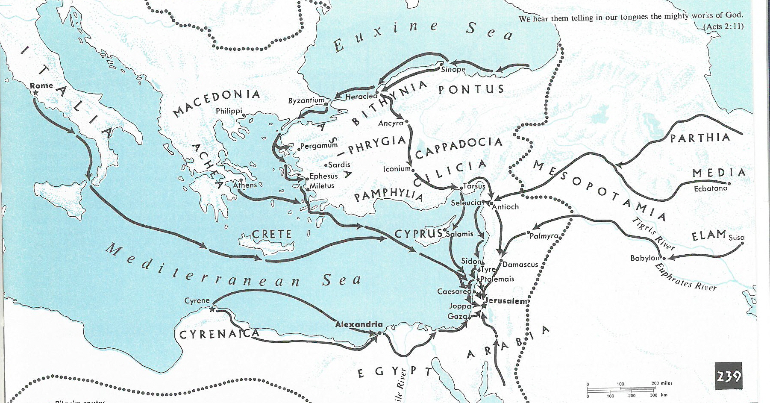
Jewish Diaspora came at Pentecost

Slide 6
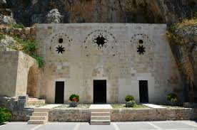
2. Antioch Church
Antioch Church | Acts 11:19-30, 13:1-12 | The Antioch Church was the first Gentile church established outside of Israel. 1) A church that loved Jesus Act 11:20, “they preached the Lord Jesus,” 11:21, “the hand of the Lord was with them, they returned to the Lord”. Act 11:23, “Stay with the Lord.” 11:24, “they were added to the Lord.” 2) The Church in the Power of the Holy Spirit Acts 13:2, “They were fasting in the service of the Lord, and the Holy Spirit said,” 13:4, “They were sent by the Holy Spirit to go down to Seleucia”. 13:9, “Saul, who was called Paul, was filled with the Holy Spirit.” 3) The Church that raised people for mission Acts 13:1, “There were prophets and teachers in the church at Antioch: Barnabas, Simeon who was called Niger, Lucius the Cyrene, Manaen the younger brother of Herod the tetrarch, and Saul.”

Slide 7
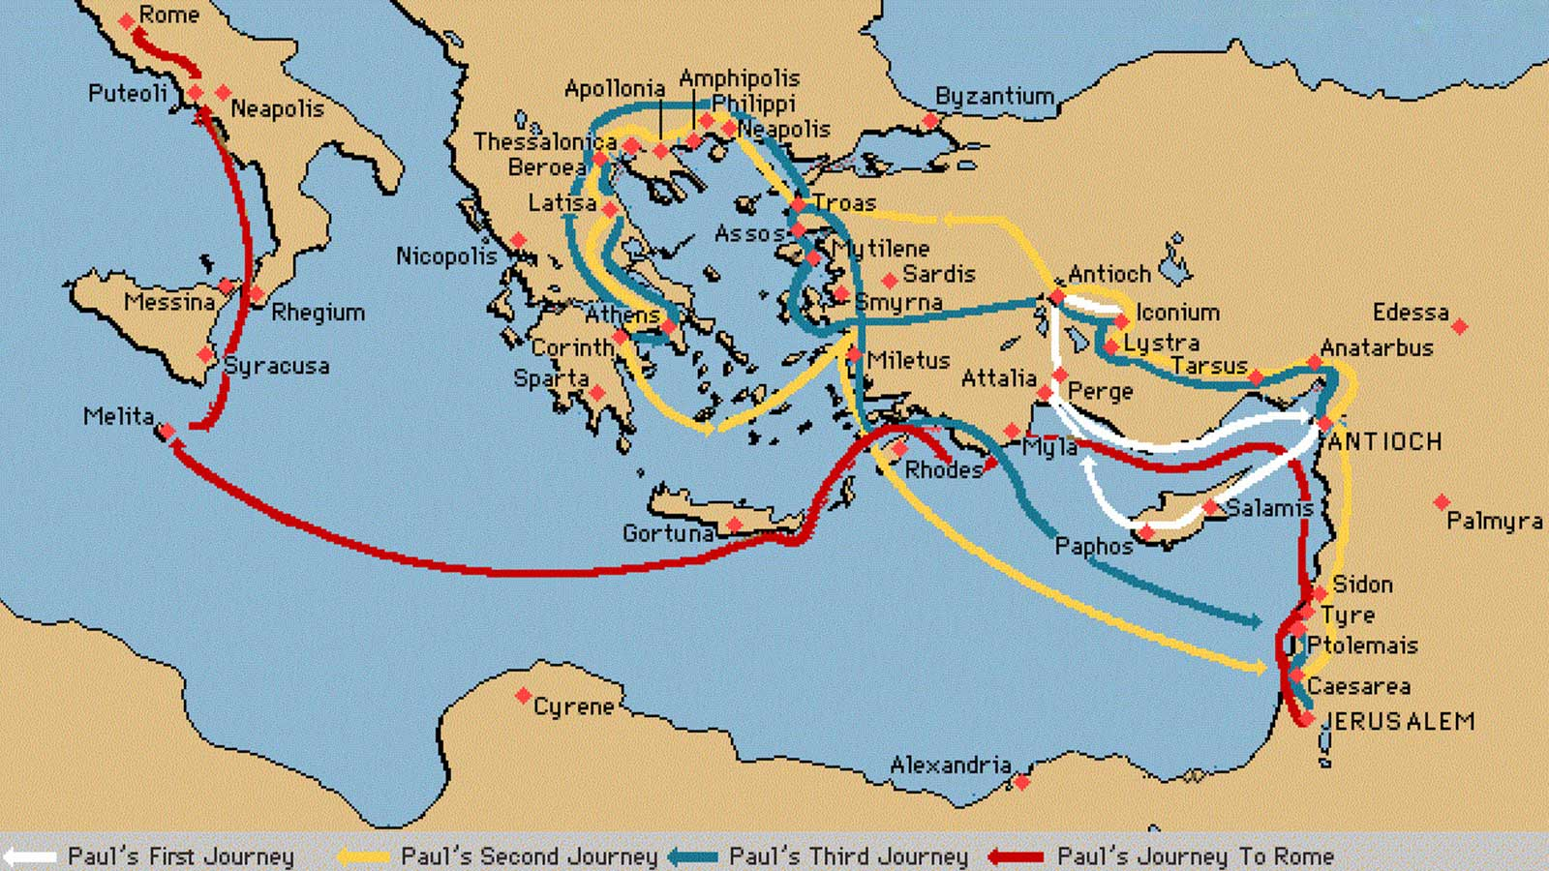
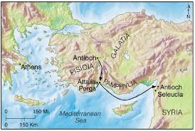
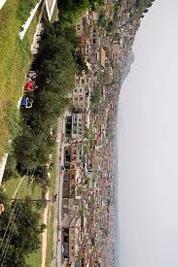
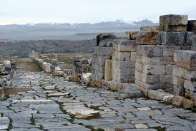
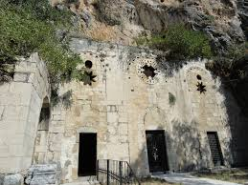
Antioch

Slide 8
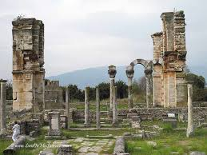
3. Philippian Church
Philippian Church | Acts 16:6-40, Phil 4:6-10 | The Philippian church was the first church in Europe 1) Macedonian vision Acts 16:7, “When they came before Mysia, they tried to go to Bithynia, but the Spirit of Jesus did not allow it.” Instead, another illusion appeared. It was when a man who introduced himself as a Macedonian appeared and said, “Help us.” 2) Many workers like Lydia, Epaphroditus to serve the church and to sacrifice for Christ Phil 2:25, ‘But I think it is necessary to send back to you Epaphroditus, my brother, co-worker, and fellow soldier, who is also your messenger, whom you sent to take care of my needs’

Slide 9
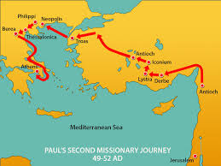
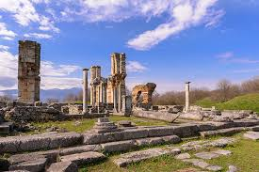
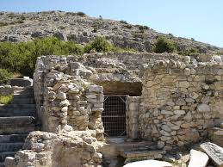
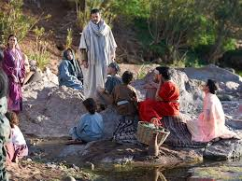
Philippi and Lydia

Slide 10
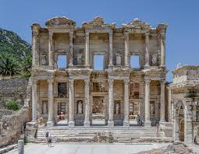
4. Ephesian Church
Ephesian Church | Acts19:8-20:38, Rev 2:1-7 | Ephesian Church was the church that Paul stayed for 3 years because of its strategic importance of Paul’s mission. 1) A Church that raised the people with the Word of God Acts 19:9, ‘He took the disciples with him and had discussions daily in the lecture hall of Tyrannus’ 2) The Church that received the praise and rebuke from the Lord Rev 2:2-4, ‘I know your deeds, your hard work and your perseverance. I know that you cannot tolerate wicked people, that you have tested those who claim to be apostles but are not and have found from false. You have persevered and have endured hardships for my name, ad have not grown weary. Yet I hold this against you: You have forsaken your first love."

Slide 11
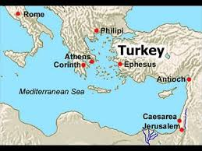
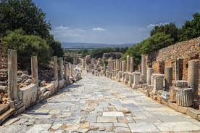
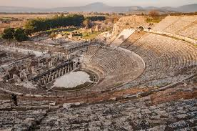
Ephesus

Slide 12
What is the Church? (Acts 20:17-38)
Introduction
Acts 20:22-23, “And now, bound by the Spirit, I go to Jerusalem, not knowing what will happen to me there, except that the Holy Spirit testifies in every city, saying that bonds and afflictions await me. But I do not account my life of any value nor as precious to myself nor as precious to myself nor as precious to myself nor as precious to myself for the course I must pursue and the ministry I have believed in the Lord Jesus, to testify to the gospel of the grace of God.”
1. Who established the church?
1) Five characteristics of the church (Matt. 16:18)
. The church is established by Jesus.
. The Lord of the church is Jesus.
. The church is destined to grow.
. The church is opposed and persecuted.
. However, the church will surely triumph.
2) The church is established by the triune God: Father (designer), Son (builder), and Holy Spirit (overseer).
3) The Church was bought with Jesus own blood: No blood, no church
2. Who will serve the church?
1) The Holy Spirit has made us over-seers
2) Two ways of serving the church
(1) Shepherding the flock (28)
(2) Guard the Shepherd (29-30)

Slide 13
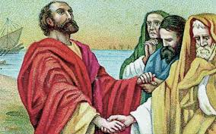
3) My Testimony: I once left the church.
The order of looking at the church was wrong
(2) The church is Jesus.
Acts 9:5, “Saul, Saul, why are you persecuting me?”
Galatians 1:13, “When I was in Judaism, I persecuted the church of God violently, saying, ”
(3) I am the church.
1 Corinthians 12:27, “Now you are the body of Christ, and each one of you is a member of it.”
(4) The church is the church not because there are no problems in the church, but because of God’s love.
“In every age, the church is imperfect. It is like a bride in an old dress. However, just as a bride is a bride not because of her clothes but because of the love of her groom, so the church is a church not because of the perfection of the church but because of the perfect love of Jesus. The perfection of the church does not come from the church itself but from Jesus, the bridegroom. The bride’s clothes were dirty that day, but they will be clean in time because the groom loves her. So it is with the church” (Hans Küng, What is the Church?)
3) Who will establish the church?
The church that was purchased with blood must be built with blood.
(1) We must sanctify ourselves daily with the word of grace (32)
(2) We must abandon material desires and focus only on Christ through a life of voluntary poverty (33-35)

Slide 14
Characteristics of Churches in Acts
Church | Jerusalem Church | Antioch Church | Philippian Church | Ephesian Church
Bible
Type and Leadership
Missional Points

