Slide 1

Paul

Slide 2
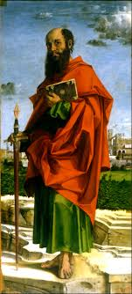
Who was Paul?
Sherman. E. Johnson,
"The Apostle Paul was one of the greatest men in human history, regardless of whether he believed in God or not. First of all, he was a great traveler. Paul traveled more than 50,000 miles abroad. Paul lived in three worlds. He was born a Hebrew and lived in the Jewish world, was born a Roman citizen and lived in the world of Greek and Roman civilization, and was reborn as a Christian. He was also a great missionary. He entered the Greco-Roman society, evangelized them in the name of Jesus Christ, and founded many churches or sowed their seeds. In addition, he was a great theologian. He was the first to systematize Christian faith and theology through 13 epistles written only 20 to 30 years after the resurrection. He was truly a wide-ranging traveler, a pioneering missionary, and a creative religious thinker."

Slide 3
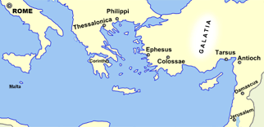
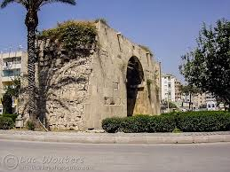
1. Paul’s Life
Birth
Acts 21:39. The commander who arrested Paul thought that Paul was an Egyptian who had started a rebellion and wanted to interrogate him. At that time, Paul stated that he was not an Egyptian but a Jew and a citizen of Tarsus.
Acts 22:3, “I am a Jew, born in Tarsus in Cilicia, but brought up in this city, educated under Gamaliel in the strictest of the Law of our fathers.’.
Acts 21:39, Paul described Tarsus as “not a small town, but a city of Tarsus in Cilicia.”

Slide 4
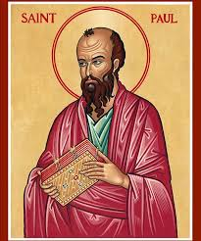
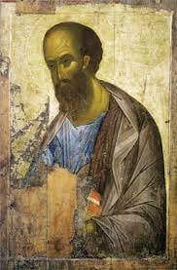
2) Appearance
2 Corinthians 10:10. "His letters are solid and powerful, but his physical presence is weak and his speech is not refreshing."
‘The Acts of Paul’,
"Paul was very short and bald. His legs were bunions. His eyebrows were straight. His nose was large and almost hooked." If this record is true, Paul was not a very handsome person. He was short and bald. His legs were crooked and his eyebrows were straight. His eyesight was poor and his nose was hooked”.

Slide 5
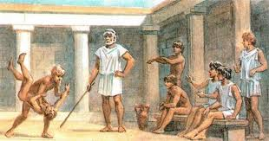
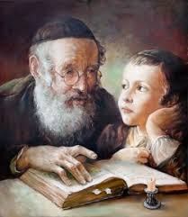
3) Education
(1) Greek Education
Greek literature such as Homo and Euripides. Physical education "gymnasium oratory
(2) Jewish Education
Acts 22:3, “I am a Jew, born in Tarsus of Cilicia, but brought up in this city. I studied under Gamaliel and was thoroughly trained in the law of our ancestors. I was just as zealous for God as any of you are today.

Slide 6
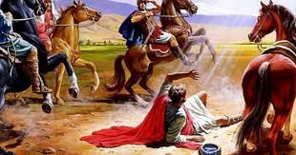
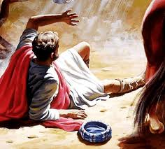
4) Persecution and conversion
Acts 9:1-2, “Saul, still breathing murderously against the disciples of the Lord, went to the high priest and asked for letters from the synagogues in Damascus, so that if he found any belonging to the Way, both men and women, he might bring them bound to Jerusalem.”. Acts 9:3, “As Saul was approaching Damascus, suddenly a light from heaven flashed around him. He fell to the ground and listened.”
Acts 22:11, “But I could not see because of the brightness of that light, so I was led by the hand of those who were with me into Damascus.”
Acts 26:13, “It was about noon, O king, and on the road I saw a light from heaven, brighter than the sun, shining on both me and my companions.”

Slide 7
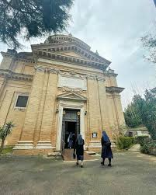
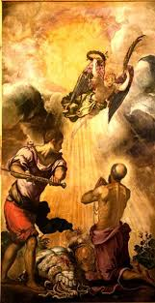
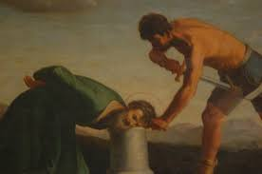
5) Martyrdom
1) First missionary journey (Acts 13:1-14:28)
2) Second missionary journey (Acts 15:36-18:22)
3) Third missionary journey (Acts 18:23-21:16)
4) Fourth journey (Acts 27-28)
According to Tertullian, Paul was killed in 67 AD by Emperor Nero in "Laurentine," five kilometers from Rome. According to him, when Paul was martyred, his head fell off and splashed three times, and water gushed out from each of those three places. That is why the place is called "Tre Fontana", which means "three counts". When entering the church, Paul was naked, his hands tied behind his back, and his head was sticking out from a sharp stone pillar

Slide 8
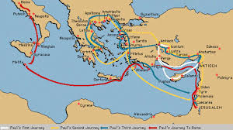
2. Paul’s Missionary Journey and writings
1st Mission | 2nd Mission | 3rd Mission | 4th Mission
48-49 A.D (Act 13-14) | 51-52 A.D (Act 15-18) | 53-57 A.D (Act 19-20) | 59-60. A.D (Act 27-28)
Galatia (Southern Turkey) | Macedonia, Greece (Corinth) | Asia (Ephesians) | Rome
Galatians (Timothy) | 1,2 Thessalonica (Priscila, Aquila) | 1,2 Corinthians, Romans | Ephesians, Philippians, Colossians, Philemon, Titus, 1,2 timothy

Slide 9

3. Paul’s Theology of Mission
1) Galatians : Missionary Confession of Faith
Gal 2:20, I have been crucified with Christ and I no longer live, but Christ lives in me. The life I now live in the body, I live by faith in the Son of God, who loved me and gave himself for me.
Crucified with Christ
He lives in me
I live by faith

Slide 10

2) Romans: Theology of Mission
Romans | 1-11 |  |  |  | 12-16
Focus | Faith (Believing) |  |  |  | Ethic (Living)
Reference | 1:1-3:21 | 3:22-5:21 | 6:1-8:17 | 9:1-11:36 | 12:1-16;27
Topic | Sin | Salvation | Sanctification | Sovereignty | Spiritual Life
(1) Missions are necessary because of human sin.
Romans ch 1 | Romans ch 2 | Romans ch 3
Sin of the Gentiles | Sin of the Jews | Sin of All men
Not knowing God (1:21) | Not acting God(2:23) | Not accepting God (3:9)

Slide 11
(2) The gospel is salvation, so missions are necessary.
Romans 3:24-25, "and we are freely justified by his grace through the redemption that came by Christ Jesus. God presented him as a sacrifice of atonement, through his blood in his blood. He did this to demonstrate his justice, because in his forbearance he had left the sins committed beforehand unpunished".
(3) We must do missionary work because we become holy when we are saved
Romans 6:8, Now if we died with Christ, we believe that we will also live with him.
(4) We are transformed through the presence of the Holy Spirit.
Romans 8:9, “if the Spirit of God lives in you.” verse 11, Romans 8:11, “if the Spirit of him who raised Jesus from the dead is living in you”.. Romans 8:26-27 today. “In the same way the Spirit helps us in our weakness, and we do not know how to pray as we ought, but the Spirit Himself intercedes for us with groanings too deep for words. He who searches hearts knows the thoughts of the Spirit, because the Spirit intercedes for the saints according to the will of God.”

Slide 12
(5) We must do missionary work so that all Gentiles can be saved along with the Jews.
Romans 11:25 I do not want you to be ignorant of this mystery, brothers and sisters, so that you may not be conceited: Israel has experienced a hardening in part until the full number of the Gentiles has come in.
(6) Missions make people worship God.
Romans 12:1, ‘12 Therefore, I urge you, brothers and sisters, in view of God’s mercy, to offer your bodies as a living sacrifice, holy and pleasing to God—this is your true and proper worship.

Slide 13
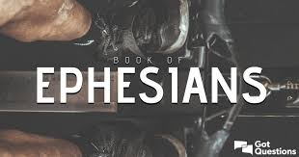
3) Ephesians: Missional Church
1 | 2 | 3 | 4 | 5 | 6
God |  | Church |  | World
Trinity God | Jesus | Nature of Church | Ministry of Church | Family in the world | Spiritual warfare in the world
Preparation of mission |  | Missional Church |  | Missional world
(1) Chapter 1-2 is the trinitarian God’s preparation for mission
God | 1:3-6 | 1:4, ‘For he chose us in him before the creation of the world’. God the Father created the world, chose us, and foreordained us. (Ceation, ELection, Predestination)
Christ | 1:7-12 | 1:7, ‘In him we have redemption through his blood his, the forgiveness of sins. Jesus atoned for our sins and adopted us. (Redemption, Forgiveness, Adoption)
Holy Spirit | 1:13-14 | 1:13, “You were marked in him with a seal, the promised Holy Spirit (Hearing, Sealing, Guarantee)

Slide 14
(2) Chapter 3-4 is the characteristics of the missional church.
4:7 4:11-12 4:15-16
In Chapter 3-4, the order of forming the church is that God first gives ‘gifts’, sets up ‘workers’ who fit those gifts, and the ‘body of Christ’ is built up through those workers.
. Gift-oriented ministry
4:7, ‘to each one of us grace has been given as Christ apportioned it’
. 5 ministries (offices)
4:11-12, ‘So Christ himself gave the apostles, the prophets, the evangelist, the pastors and
teacher’ (the apostles, the prophets, the evangelist, the pastors and teacher’
. Growing church as a body of Christ
4:16, ‘From him the whole body, joined and held together’
(3) Chapter 5-6 is the mission field.
5:18, Do not get drunk on wine, which leads to debauchery. Instead, be filled with the Spirit.

Slide 15
4. Paul’s Mission Strategy
City-centered Mission | Paul's mission was the center of the metropolis. A major metropolis is Antioch (Syria), Thessalonica (Macedonia), Corinth (Achaia), Ephesus (Asia), Rome (Italy)
Mission by using the synagogue | Wherever Paul went, he preached and preached in synagogues built for the Jews (4 sermons in the synagogue)
Team Mission | Paul missions as a team. (Priscilla, Aquilla, Apollo, Epaphra, Epaphroditus, Aristarchus, Gaius, Jason, Timothy, Luke, Mark)
3 Self-Mission | Self-Propagation for evangelism, Self-Governance for management, Self-Reliance for supporting

