Slide 1

Thessalonica

Slide 2
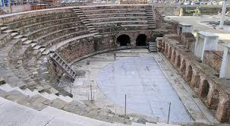
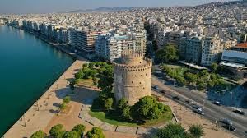
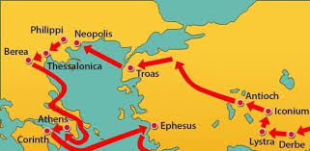
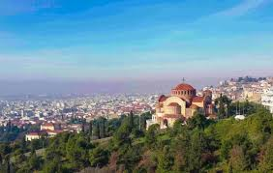
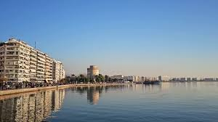
Thessalonians

Slide 3
1. Book
Acts (49-50. A. D) | 1 Thessalonians (51-52 A.D)
Acts 17:1-9. Some wicked men formed a mob, attacked Paul, and Paul was sent to Berea | 1 Thessalonians 1:8-9, ‘Your faith in God has become known everywhere...you turned to God from idols to serve the living and true God’. 3:7-8, ‘For now we live, since you are standing firm from distress and persecution’.
Book

Slide 4
2. How was the Thessalonian church changed?
1 Thessalonians 1:3, ‘Your work produced by faith, your labor prompted by love, your endurance inspired by hope in our Lord Jesus Christ’.
Act 17:1-15 (AD.51) | 1Thessalonica 3:1-5, 1:2-5 (written in Corinth, where Paul stayed for 18 months) | 1 Thessalonica 1:5-10, 3:7-8 (A.D 53)
persecution, suffering, flight | Timothy was sent, prayer, encouragement | Became a famous church and a role model
Natural Growth | Consequent Growth | Intentional Growth
Mark 4:27, ‘Night and day, whether he sleeps or gets up, the seed sprouts and grows though he does not know how’. | Rom 5:3, ‘Because we know that suffering produces perseverance; perseverance, character; and character, hope.’ | Psalm 126:6, ‘Those who go out weeping, carrying seed to grow, will return with songs of joy.’
1 Thessalonians 1:5, 'Our gospel with power, with the Holy Spirit and deep conviction' salvation'.
1 Thessalonians 2:7, ‘Just as a nursing mother cares for her children’
1 Thessalonians 2:11, 'As a father deals with his children, encouraging, comforting, and urging,' and urging.

Slide 5
3. Paul’s Mission in Thessalonica
(1) Big Cities
City-Centered
1 “Thessalonians 1:8, ‘Word of the Lord is heard from you not only in Macedonia and Achaia”
Paul thought that everyone needed to hear the message of Jesus Christ. Paul's behavior was normal at the time. Even in early Christian history there were itinerant preachers who toured the land of Judah. At that time, Jews were scattered around the world as diaspora.
Paul chose cities that were representative, not raciallybut regionally. Amphipolis and Apollonia were big cites but passed by. Acts 14:6-7, “We went to Lycaonia and the two cities Lystra and Derbe and their vicinity,” Paul was not just an itinerant preacher
Since the cities and towns of the Mediterranean at that time were within the political structure of the Roman Empire
Region | City | Acts | Event
Syria | Antioch | 13:1-14:28
Galatia | Picidian Antioch | 13:14-52
 | Lystra, Iconion | 14:1-20
 | Derbe | 14:1-28
Macedonia | Phillipi | 16:11-40
 | Thessalonica | 17:1-9
 | Berea | 17:10-15
Achaea | Athens | 17:16-34
 | Corinth | 18:1-17
Asia | Ephesus | 19:1-20:1
Rome |  | 28:30-31

Slide 6
Church ministry in the cities
Church Established | Sending Disciples | Encouragement and education by letter | Revisit, Care
Training core members to establish a church | Sending out trained disciples to take care of the church | Encouragement, instruction, correction needed in letters | Revisit to review and mentoring

Slide 7
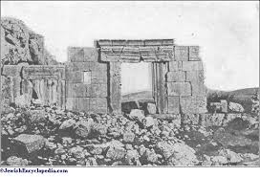
2) Synagogue
Acts 17:2, “Paul went in to them according to the custom of the housekeeper, and for three Sabbaths reasoned with them from the Scriptures”(Acts 17:2).
The records of Paul's visits to synagogues include Damascus (Acts 9:20), Antioch (Acts 11:24), and Cyprus (Acts 13:5). (Acts 14:10, Philippi (Acts 16:12-13), Thessalonica (Acts 17:1), Berea (Acts 17:10), Athens (Acts 17:17), Corinth (Acts 18:1-4) , Ephesus (Acts 18:19, 19:8).
* The reason he visited the synagogue
As a Jew
The synagogue were provided everywhere Paul visited
It was because I was able to meet various people
Synagogues allowed Jewish teachers and rabbis to give “words of exhortation”
An example of synagogue evangelism (Antioch in Pisidia) (Acts 13:13-52)

Slide 8
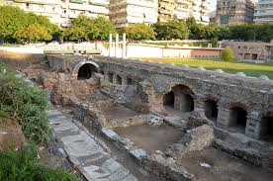
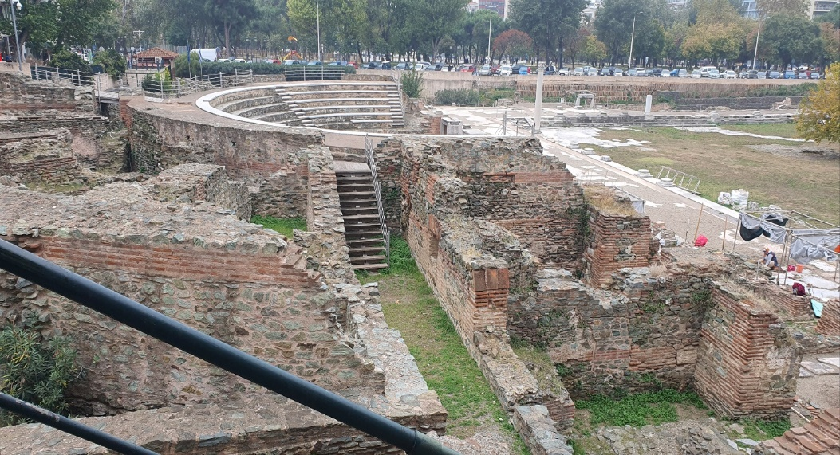
3) Agora, Forum
Acts 17:17, 'In the synagogue with the Jews and the pious, and in the marketplace with those who meet every day’.
Acts 17:3, “Explaining and proving that the Christ had to suffer and rise again from the dead, saying, “This Jesus, whom I am preaching to you, is the Christ.

Slide 9
M.A.W.L Model
(4) Team Mission
1 Thessalonians 3:1-3, “For this reason, when we could not bear it any longer, it seemed good to us to remain alone in Athens, and we sent Timothy, our brother, a minister of the God of the gospel of Christ, to strengthen you and comfort you in your faith, so that anyone who so as not to be shaken during tribulation”
Modeling | Assisting | Watching | Leaving
Show an example with life (example) | Help with the Word and prayer (training) | Let them do it themselves and watch it (practice) | Leave completely entrusted (delegation)
Conversion experience of encountering Christ through evangelism | Nurturing through discipleship training | Church establishment, propagation, and nurture through cell (house church) | Administrative, Spiritual Delegation, Independence
Paul's co-worker
Group | Co-worker
An independent co-worker who worked together for a short time in the church established by Paul | Priscilla and Aquila, Apollos
The co-workers Paul was most familiar with and traveled regularly with | Timothy, Tidus, and Silas (Sylvanus). They are responsible for conciliating Paul and the church he founded, raising money for the Jerusalem church, and delivering letters in his name.
Co-workers sent from the church established by Paul | The Bible calls them “the apostles of the church” (2 Cor. 8:23, Phil. 2:25). Stephanas (1 Cor 1:16), Bethanus, Achaic (1 Cor 16:15-18), Epaphroditus (Philippians 2:25-30), and the names in Romans 16 and 1 Corinthians 16 belong to this category. Epaphroditus, Euodia, Syntyche, and Clement of the Philippian church.

Slide 10
What we learn from Paul’s mission in Thessalonica
1) If we persevere until the end even in hardships, missionary work will be successful
Psalm 126:5-6, ‘Those who sow with tears will reap songs of joy. Those who go out weeping, carrying seed to sow, will return with songs of Joy, carrying sheaves with them’.
Gal 6:9, ‘Let us not become weary in doing good, for at the flesh will reap a harvest if we do not give up’.
7 Characteristics of the Life of a true worker of God (1 Thess 2:1-12)
A true worker must set an example (10-12).
A true worker must be recognized by God (4).
A true worker does not give up or make excuses to serve the Lord faithfully with a steadfast heart
A true worker does not work for financial gain but is only motivated to do what is pleasing to God (3-5).
A true worker does not claim authority, but rather refrains from exercising his power (7).
A true worker treats his brothers with the heart of a mother raising his children (7-8).
A true worker treats their brothers like a father with his children (11-12).
Act 17:1-15 (AD.51) | 1Thessalonica 3:1-5, 1:2-5 (written in Corinth, where Paul stayed for 18 months) | 1 Thessalonica 1:5-10, 3:7-8 (A.D 53)
persecution, suffering, flight | Timothy was sent, prayer, encouragement | Became a famous church and a role model

Slide 11
2) Paul's tears and prayers.
Acts 20:19, “All humility and tears, and serving the Lord with endurance of temptation through the trickery of the Jews.”
3) Timothy's hard work.
1 Thessalonians 3:6, “Now Timothy has come from you and is telling us the good news of your faith and love".
1 Thessalonians 2:11. ‘As you know, we admonish, comfort and admonish each of you as a father does his own children’.
4) Mission is God’s own work
Thessalonian mission in Acts 17 was not smooth. Eventually, Paul was kicked out in the middle of the night and hurriedly moved to Berea as if running away. However, there were many fruits among the tribulation. Acts 17:4, "Some of them, a large crowd of devout Greeks and not a few notable women, were persuaded to follow Paul and Silas." Because missions is God's work, it must bear fruit. There is no failure in any mission. The only one failure is our disobedience to his calling. ‘If we obey, God works’, ‘If we do the possible, God will do the impossible’, ‘If we start, God will finish’.

Slide 12
“I wasn’t God’s first choice for what I’ve done for China. I don’t know who it was. It must have been a man—a well–educated man. I don’t know what happened. Perhaps he died. Perhaps he wasn’t willing. And God looked down… and saw Gladys Aylward. And God said, ‘Well, she’s willing.’”– Gladys Aylward, missionary to China
“God is a God of motion, of movement, and of mission… Mission is not an activity of the church but an attribute of God. God is a missionary God, Jesus is a missionary Messiah, and the Spirit is a missionary Spirit. Missions is the family business.” – Len Sweet
“Do we claim to believe in God? He’s a missionary God. You tell me you’re committed to Christ. He’s a missionary Christ. Are you filled with the Holy Spirit? He’s a missionary Spirit. Do you belong to the church? It’s a missionary society. And do you hope to go to heaven when you die? It’s a heaven into which the fruits of world mission have been and will be gathered.”– John R. W. Stott89.
“It’s not that God has a mission for his Church in the world, but that God has a Church for his mission in the world.” – Chris Wright

Slide 13
5) Second coming
1 Thessalonians | 2 Thessalonians
The imminence of the Lord’s return | Correction of the misunderstandings about the Lord’s return
4:13, 5:1-4 4:16, ‘For the Lord himself will come down from heaven, with a loud command, with the voice of the archangel and with the trumpet call of God’ 5:2, ‘The day of the lord will come like a thief in the night’ | 2:1-12, 3:6-15 2:2, ‘Not to become easily unsettled or alarmed by the teaching’ 3:11-12, ‘We hear that some among you are idle and disruptive. They are not busy, they are busybodies’

