Slide 1

Phillip
Acts 8:1-40

Slide 2

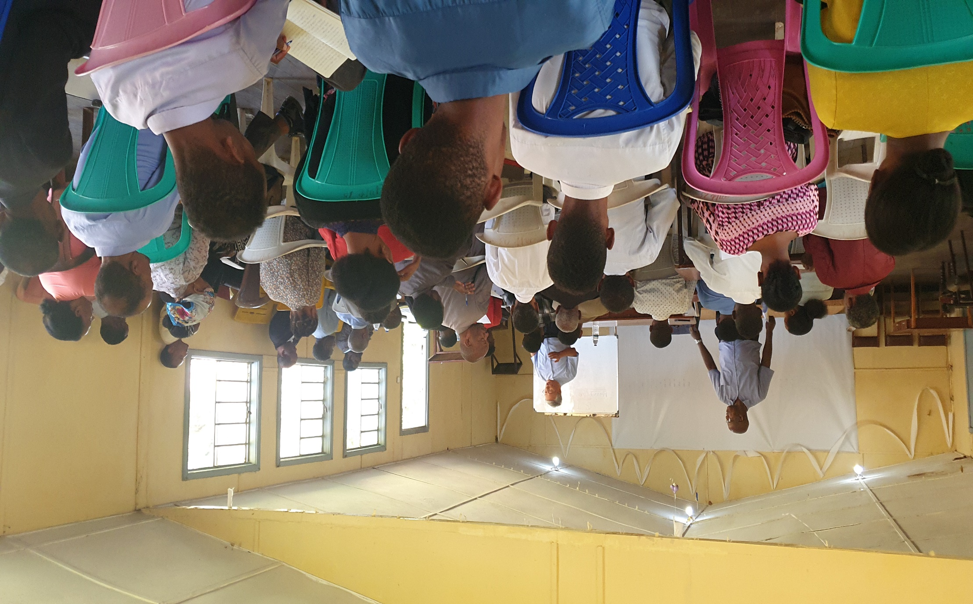
Jimma Seminary (Ethiopia)

Slide 3
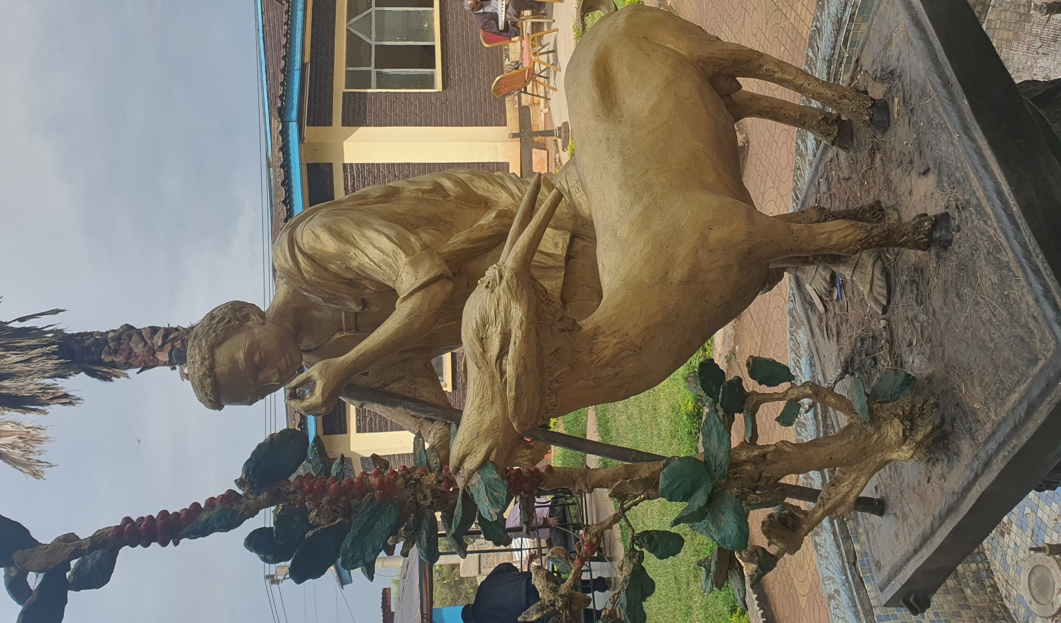
Shepherd and Coffee (Kaffa, Ethiopia)

Slide 4
Synopsis of the story of Phillip
Go | By the power of Holy Spirit |  |  | Be witnesses
Scattered | Evangelism | Prayer | Word | Personal and historical transformation

Slide 5
1. Go (Those who are scattered)

Slide 6

Acts 8:1
On that day a great persecution broke out against the church in Jerusalem and all except the apostles were scattered throughout Judea and Samaria.

Slide 7
Scattered Christians in the early Church | 히브리적 사랑
In Israel | Out of Israel
Jude, Samaria, Nazareth Nazarene (Acts 24:5) | Pella, Negev, Antioch Christian (Acts11:26)

Slide 8
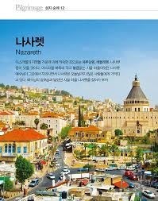
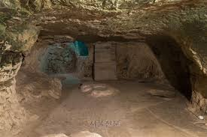
Cave in Nazareth

Slide 9
2. By the power of Holy Spirit
1) Evangelism
Act 1:8 Be my witnesses --------------------------------> Act 8:1 scattered
Proclamation | Persuasion | Power
Declaring with Words (Peter, Act 2:14) | Explaining in detail (Apollo, Act 18:26) | Showing miracles with signs (Paul, Act13:9)

Slide 10
Bridge Evangelism
God | Problem | Solution | Response | Next step
John 3:16, John 10:10 | Rom 3:23, Rom6:23 | John 14:6, Rom 5:8 | John 1:12, Eph 2:8 | A: Accept B: Believe C: Commit Prayer

Slide 11
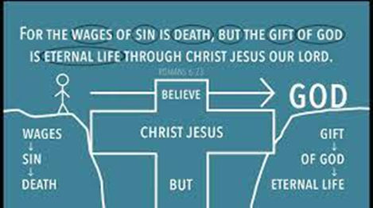

Slide 12
Group Evangelism
Prayer | Relationship | Invitation | Multiplication
VIP card | P(Pen, pasta, present), S(spend, serve, supply) | Invite to small group first, then to Church | Reproduction by discipleship

Slide 13
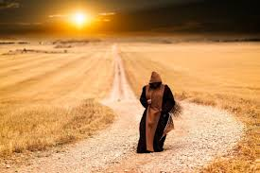
2) Prayer
Mission is the work of the Holy Spirit
. Go to Gaza
. Go to the Chariot
. Speak to him
(2) Prayer taught by Jesus
Mission is the work pf the Holy Spirit
Prayer taught by Jesus (3C Prayer)
Communication, prayer of heart | Cry, prayer of supplication | Combat, prayer of spiritual fighting
마6:1-9. in the closet, in secret Pray with God | 마7:7-8 Ask, Seek, and knock Pray to God | 마12:28-29 Bind the strong man Pray as God

Slide 14
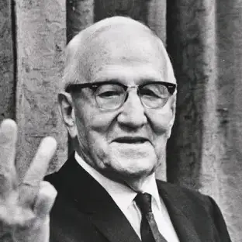
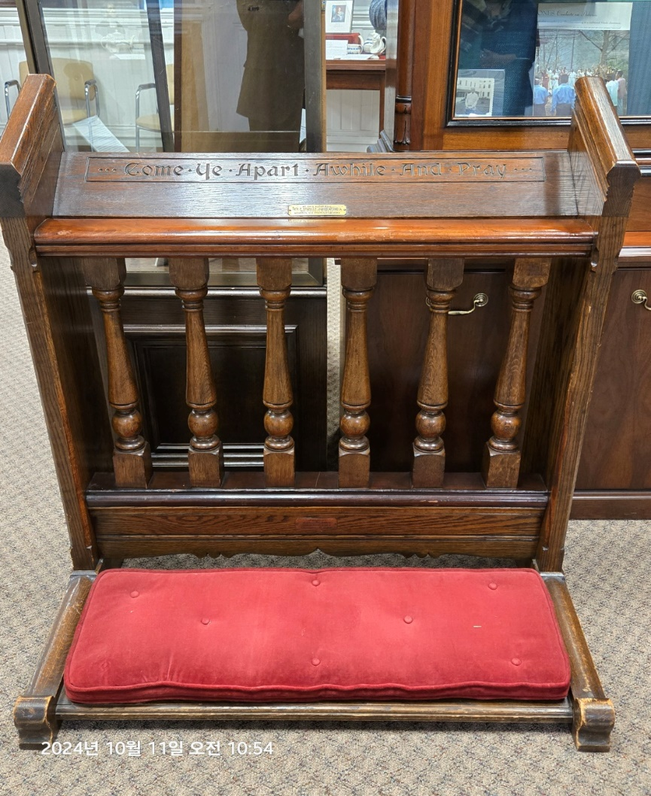
Staney Jones

Slide 15
Ephesians 1:19, “And his incomparably (immeasurably) great power for us whop believe. That power is the same as the mighty strength)

Slide 16
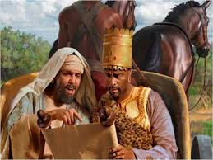
3) Word
The Bible is the Word of God
Acts 8:27-28, "And he got up and went and saw an Ethiopian eunuch, a treasurer under Candace, queen of the Ethiopians, who had come to Jerusalem to worship, and was returning, sitting in his chariot, reading the prophet Isaiah.“
(2) Hand of Word
Hand of Word
Hearing | Reading | Studying | Meditation | Memory
Rom 10:17 | Rev. 1:3 | Act 17:11 | Ps 1:2 | 시Ps 119:9,11

Slide 17
How can we read the Bible?
Observation | Interpretation | Application
What is this? | What does it mean? | How do we apply the Word into our life?
Understanding | Meaning | Practice into Life

Slide 18
Acts 8:35
Then Philip began with that very message of Scripture and told him the good news about Jesus

Slide 19
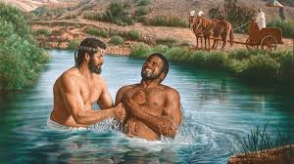
3. Be Witnesses
Personal Change
Baptism
Acts 8:36, “As they went along the road, they came to some water. The eunuch said, ‘Look! Here is water! What prevents me from being baptized?’
Die (I have died with Christ) | Live (I live with Christ)
. . Take off your clothes, anoint yourself with oil, and go into the water. Immerse yourself in water. | .Put on your clothes (baptismal clothes) and come out of the water (Gal. 3:27). Make the sign of the cross (1 Cor. 1:4). Receive the anointing oil. Receive candles. Participate in the Eucharist and receive bread and wine.

Slide 20
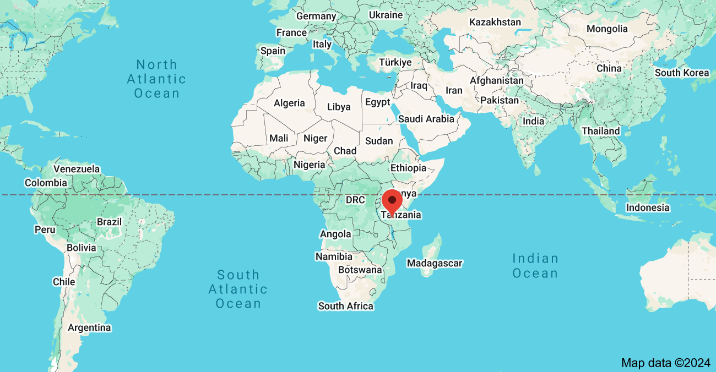
2) Historical Changes
Ethiopia became the first Christian country in 330 A.D.
(2) Africa became the center of world Christianity for 500 years

